Slide 1
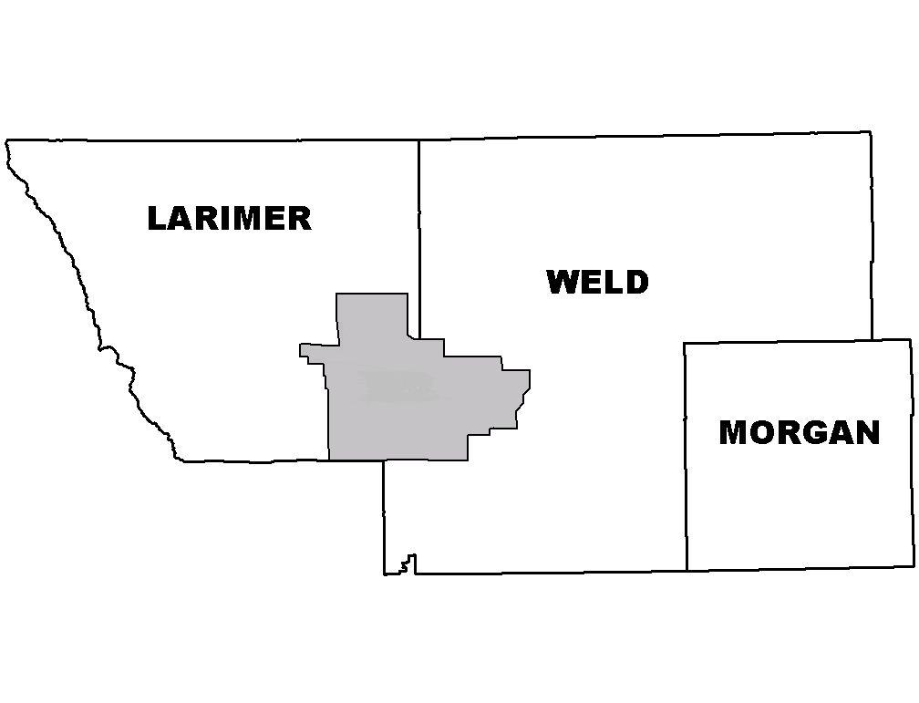
UFR TPR Quarterly Meeting
UPPER FRONT RANGE
TRANSPORTATION PLANNING REGION
REGIONAL PLANNING COMMISSION
December 5, 2024
CDOT R4 Headquarters
WELCOME & INTRODUCTIONS
APPROVAL OF MINUTES

Slide 2
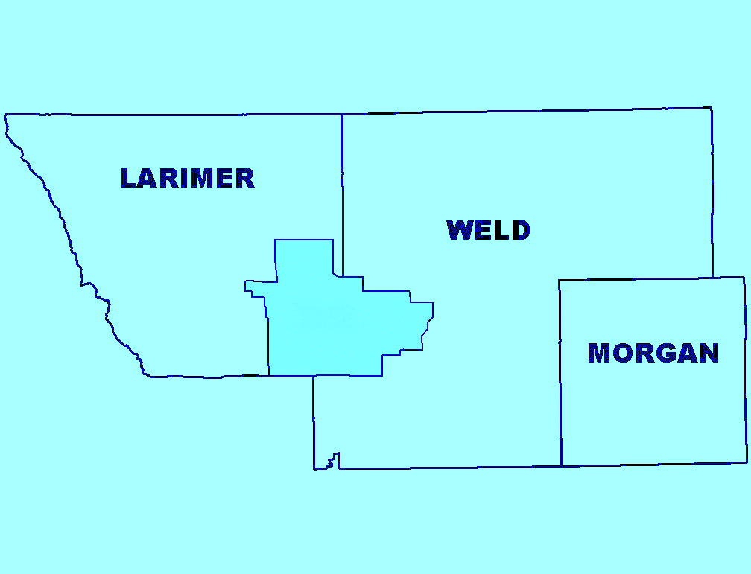
UPPER FRONT RANGE
TRANSPORTATION PLANNING REGION
REGIONAL PLANNING COMMISSION
PO BOX 758, Greeley, Colorado 80632
• 3. Approve Meeting Dates & Locations for 2025 – Chair
• 4. Election of Chair & Vice Chair for 2025 – Chair
• 5. Transportation Commissioner Appointment Update – CDOT
• 6. NAAPME Community Clean Transportation Assistance Grant Funding Program – Darius Pakbaz
• 7. Approve & Sign Resolution for CMAQ FY24 Project Award SH 52/WCR 59 Roundabout – Evan Pinkham
• 8. FY 24-28 MMOF Projects Presentations – Project Sponsors
• 9. Resolution of support for MMOF Match Reduction requests
• 10. CDOT 2050 RTP – Marrissa Gaughan
• 11. FHWA FLAP Central Federal Lands – Andrew Valdez
• 12. CDOT Presentation SH 14 Safety Plan – Bryce Reeves
• 13. CDOT INFRA Grant Award – US 287 Safety Improvement Project – CDOT
• 14. Community Roundtable
• 15. Public or Additional Comments
• 16. Inactive Projects Report (Handout)

Slide 3
Mark Your Calendars

Slide 4

Election of Chair & Vice Chair for 2025

Slide 5
Transportation Commissioner
Appointment Update

Slide 6
“Community Clean Transportation Assistance” Grant Funding Program
(CCTAP) - Fall 2024

Slide 7

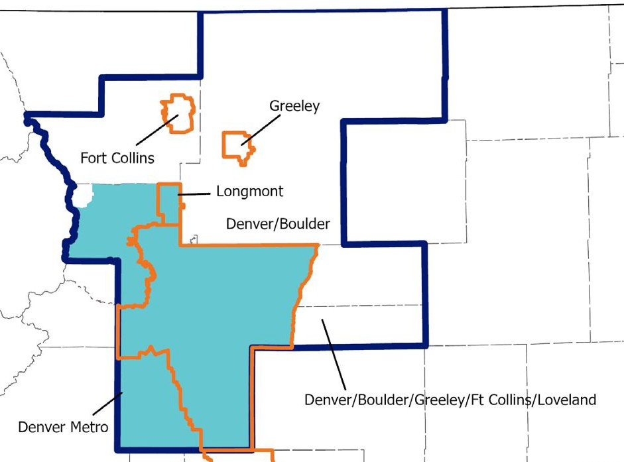
“Community Clean Transportation Assistance” Grant Funding Program (CCTAP) - Overview
Colorado Senate Bill 21-260 created the Nonattainment Area Air Pollution Mitigation Enterprise (NAAPME): naapme.codot.gov
NAAPME funds projects that help address traffic congestion and reduce environmental and health impacts of transportation in Colorado’s Nonattainment areas (currently Metro Denver, North Front Range, and Upper Front Range).
CCTAP is the first NAAPME grant funding program, with $17 million available.

Slide 8
“Community Clean Transportation Assistance” Grant Funding Program (CCTAP) - NOFO
Notice of Funding Opportunity
The NAAPME 10-Year Plan identifies these funding focus areas:
  Projects that sustainably reduce traffic congestion
(transit services, mobility hubs, sidewalks & bike paths, car-/van-pools, etc.);
  Projects that reduce the environmental and health impacts of transportation
(lowering construction impacts, roadside vegetation, etc.); and/or
  Projects that improve neighborhood connectivity for communities adjacent to highways
(sidewalks, bike/ped connectivity, reduce urban traffic speeds, etc.).
Federal “Congestion Mitigation and Air Quality (CMAQ)” Project types
are also eligible for this funding.
Project awards of $500,000 to $17,000,000

Slide 9
“Community Clean Transportation Assistance” Grant Funding Program (CCTAP) - Eligibility
CCTAP Eligibility Criteria
Eligible project sponsors meet criteria under 43-4-1302 C.R.S.
Eligible project sponsors are in good standing with the Colorado Secretary of State, have no projects on the federal inactive list, and have not had a non-compliance determination on a sub-allocated recipient audit/visit.
Projects must demonstrate and report emissions reduction benefits in ozone precursors (CDOT can provide technical assistance).
Proposed transportation infrastructure must complete a review of the project proposal for feasibility of their scope.
20% local match (hardship waivers possible)
Infrastructure projects are open to the general public, ADA-compliant, and comply with with any other applicable rules and regulations.

Slide 10
“Community Clean Transportation Assistance” Grant Funding Program (CCTAP) - Evaluation
CCTAP Evaluation Criteria (Points)
Emissions reduction benefits in ozone precursors (25)
Project is located within or supports a disproportionately impacted community, demonstrated outreach to engage with those communities, and how the project would help address community needs and/or issues (25)
Project meets NAAPME business purpose and funding focus areas (15)
Project is prioritized in an approved transportation improvement plan (15)
Demonstrates likelihood of successful project delivery, including commitment for long-term maintenance of infrastructure projects (5)
Demonstrates that the project improves traveling safety, especially for vulnerable road users (5)
Demonstrates improvement/expansion of transportation choice or neighborhood connectivity (5) Quality of the Application (5)
•
•
•

Slide 11
“Community Clean Transportation Assistance” Grant Funding Program (CCTAP) - Timeline
CCTAP Application Timeline
November 2024 through February 2025: Open period for questions, technical assistance, and identification of engineering review of proposed project.
5:00 p.m., Feb. 25, 2025: Deadline to Submit Draft Applications for Review
March through April 2025: Technical review of applications review for project feasibility.
5:00 p.m., April 30, 2025: Deadline to Submit Final Applications.
May 2025: Applications evaluated by Enterprise staff
4:30 p.m., June 26, 2025: Board of Directors review and award projects.
No later than July 31, 2025: Award Notices Sent to Applicable Parties

Slide 12
“Community Clean Transportation Assistance” Grant Funding Program (CCTAP) - Engagement
CCTAP Plans for Public Engagement
Website launch (November 4, 2024):
codot.gov/programs/naapme/naapme-community-clean-transportation-assistance-grant-funding-program
•
•
•
•
•
•
Press Releases for Start and Close of Grant
Presentations to DRCOG, NFRMPO and Upper Front Range TPR
Email messages to potential communities in the nonattainment area. NOFO in Spanish
At least one CCTAP webinar
FAQs on website (updated monthly)

Slide 13
CCTAP - Thank You, and Questions?
naapme.codot.gov
cdot_nonattainmententerprise@state.co.us

Slide 14
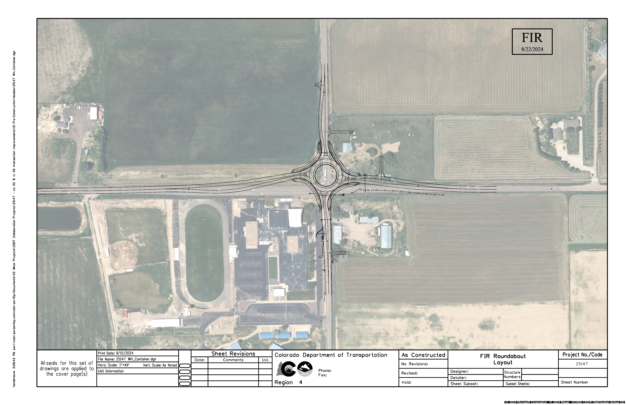
CMAQ FY24 Project Award
SH 52/WCR 59 Roundabout

Slide 15
CMAQ FY24 Resolution - SH 52/WCR 59 Roundabout
CDOT 10-Year Plan Funds – FY23-26

Slide 16

UPPER FRONT RANGE
TRANSPORTATION PLANNING REGION
REGIONAL PLANNING COMMISSION
PO BOX 758, Greeley, Colorado 80632
MMOF Projects
FY24-28
Estes Park Moraine Ave Trail
Estes Park Transit Operations
Estes Park Trolley Facility
Platteville Downtown Business District Sidewalk
Weld County On-Demand Transit

Slide 17
Resolution MMOF Match Rate Reduction
Weld County Request – 50% to 25%
Town of Platteville Request – 50% to 25%

Slide 18
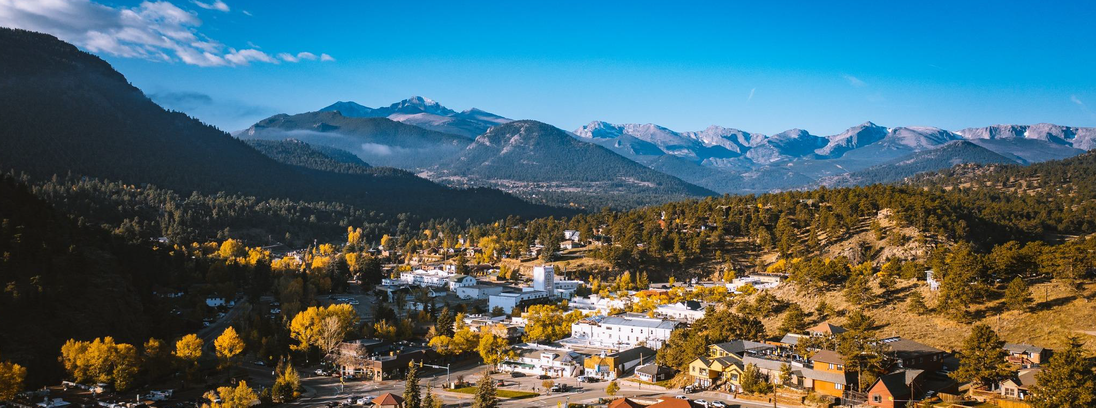

Upper Front Range TPR
Meeting #2
December 5, 2024
1

Slide 19
Meeting Purpose
Establish a set of guided conversations that will help you (as a TPR) develop your 2050 Regional Transportation Plan (RTP).
Provide refresher on RTP planning context
Provide a status update on TPR projects
Seek concurrence on vision, goals and focus areas based on TPR Member survey input
Offer ideas and seek TPR guidance on establishing 2050 RTP priority projects
2

Slide 20
What We Need From You Today
Your concurrence (or changes to) the revised vision, goals, and focus areas
Decisions on the approach that should be used to establish priority projects for 2050 RTP
  Selected approach will be executed between now and TPR Meeting #3 (March 6, 2025)
3

Slide 21
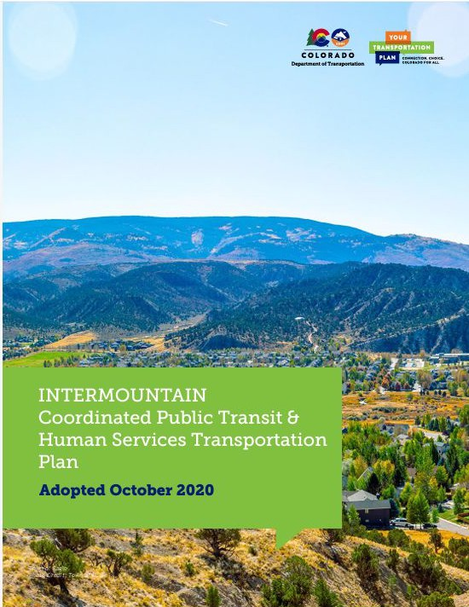
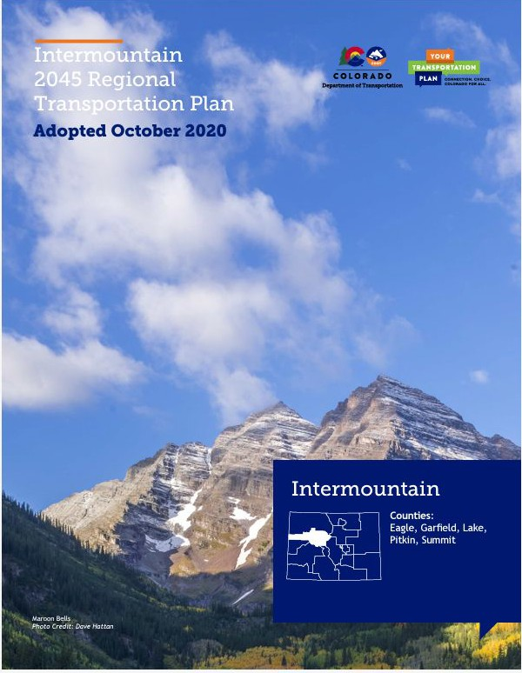
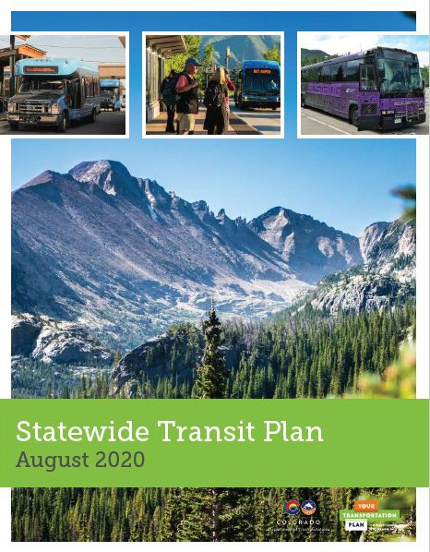
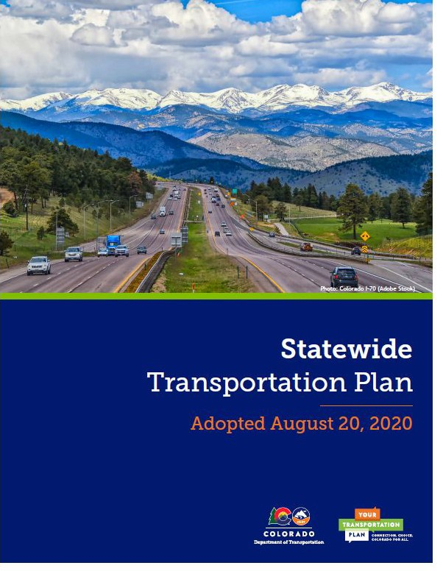
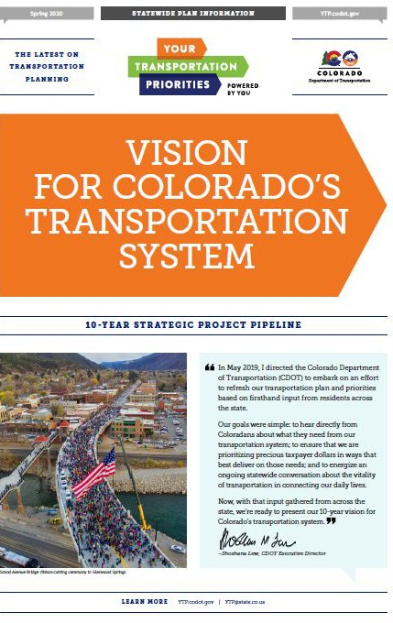
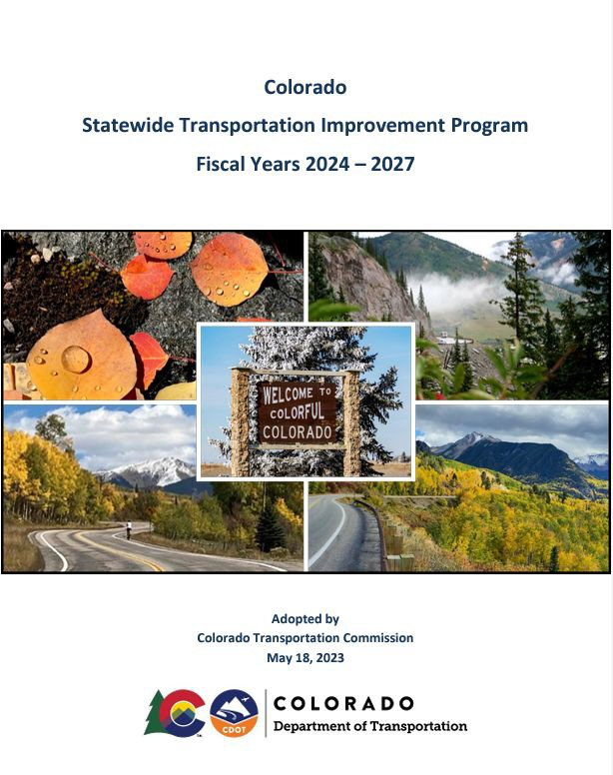
Plan Development
Statewide Transportation & Transit Plans
10-Year Plan
4-Year STIP
Regional Plans
Data Integration ● Stakeholder and Community Input

Slide 22



Policy Directive (PD) 14
Guiding Principles for Plan Development & Implementation
Advancing Transportation
Safety
No matter where you’re going or how you’re getting there, Colorado is committed to providing you a safe and efficient transportation network so you arrive at your destination safely.
Prioritize strategic investments in Colorado's highways to improve infrastructure conditions.
Fix Our Roads
Sustainably Increase Transportation
Choice
Provide alternatives to single occupancy vehicle travel that increase choices and reduce air pollution from transportation.

Slide 23
Transportation Funding
CDOT FUNDING PRIORITIES
OTHER FUNDING OPPORTUNITIES
Policy: PD 14 & Regional Needs
Project Identification:
10-Year Plan
Policy: TPR Vision/Goals
Project Identification:
TPR Priorities

Slide 24
Region 4 Strategic Highway Safety Plan (SHSP)
Workshop Results
Region 4 Strategic Highway Safety Plan Key Takeaways:
Safety Culture - foster collaboration with DICs, advance safe-first initiatives, identify policy changes, infrastructure demetrimes local safety culture
Infrastructure - infrastructure misalignment, need to prioritize safety in engineering, roadway conditions and navigation, work zone safety, historical disinvestment in DICs, adequate design for rural roadways
Collaboration and Stakeholder Engagement - align state and local agencies, bring in community to advocate for safety initiatives, CSP as a strong partner
Enforcement - explore speed cameras use, culturally sensitive communication around enforcement, workforce shortage, targeted enforcement/education
Safety Planning - Success in local safety plans, need for work zone planning and infrastructure protection, need emphasis on multimodal safety
Risky Behaviors - distracted driving, impaired and aggressive driving, perception on invincibility, and vehicle design/speed

Slide 25
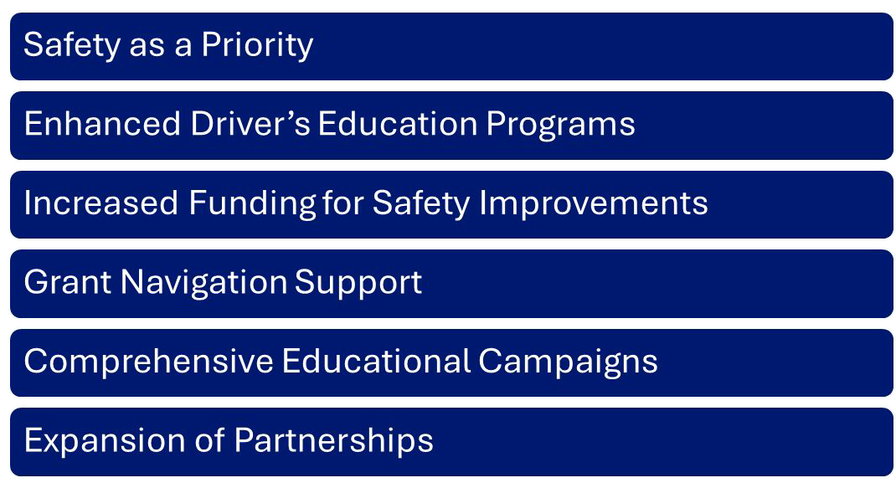
Common Themes from All Strategic Highway Safety Plan (SHSP) Workshops

Slide 26
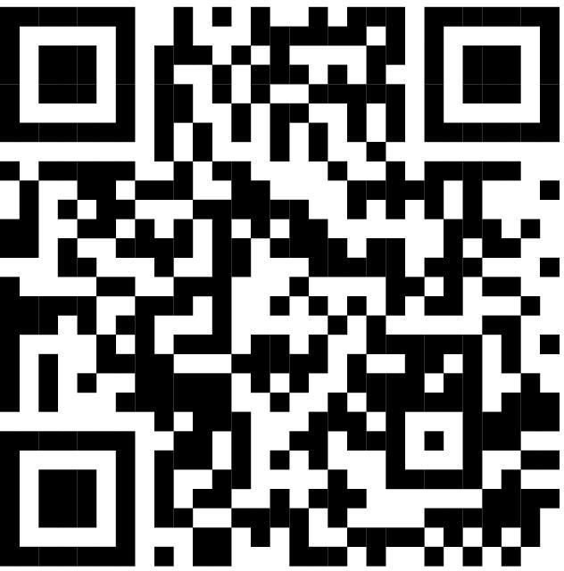
Additional Information and Resources
Additional feedback and questions regarding SHSP can be received through the following methods:
Project Team email: shsp@state.co.us
Online engagement platform: https://cdot-shsp.mysocialpinpoint.com

Slide 27
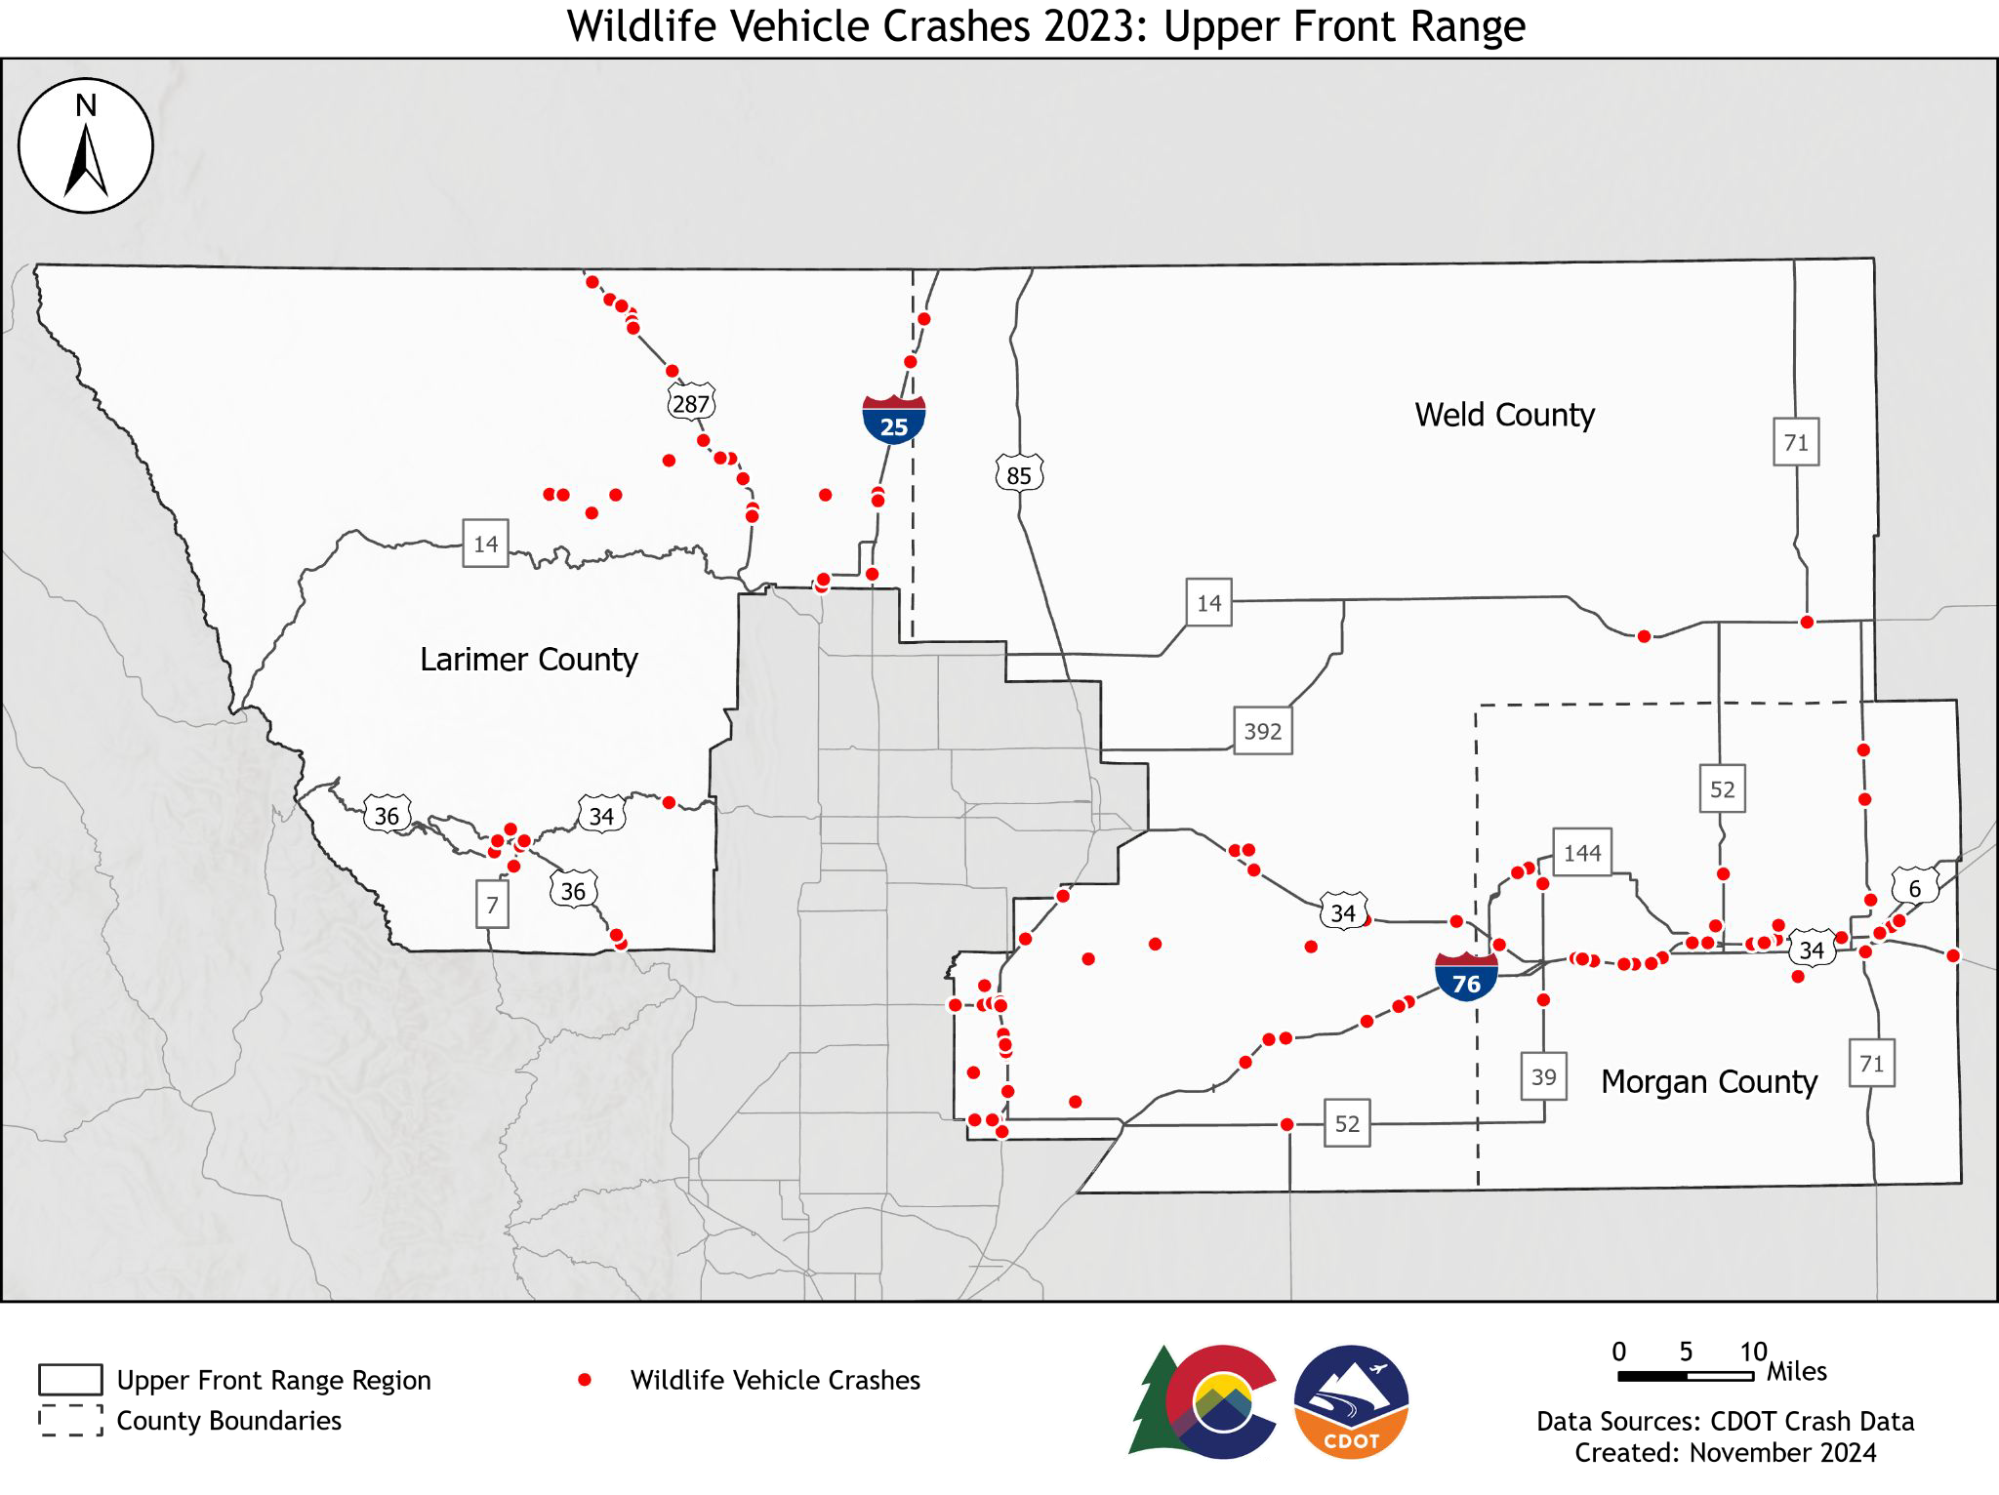
Additional Data Request: Wildlife Crash Data

Slide 28
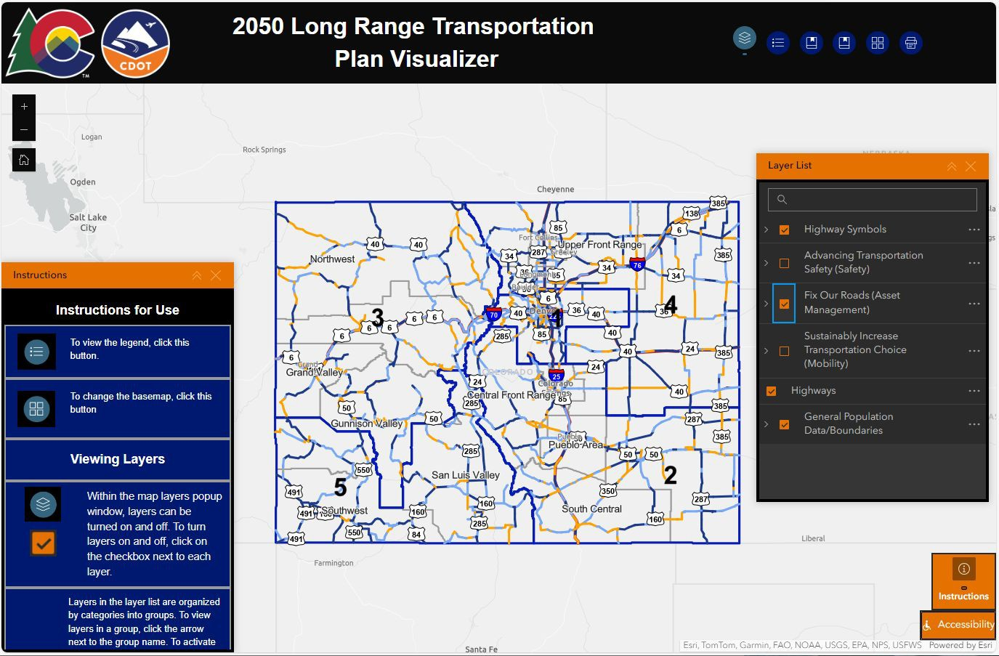
Data Visualizer
https://experience.arcgis.com/experien ce/c9ec4c30351143caaa995b6ad5ce5f44

Slide 29
Upper Front Range
VISION, GOALS, and FOCUS AREAS
12

Slide 30
Upper Front Range Vision
The Upper Front Range TPR will promote economic vitality and mobility for all residents through strategic investments in a multimodal transportation system.

Slide 31
Upper Front Range Vision - Proposed Changes
No changes were made to the 2050 Upper Front Range RTP Vision based on TPR Member Survey

Slide 32
2045 Upper Front Range RTP Goals & Survey Results
2045 Goal | Modify | Delete | No Change
Improve safety throughout the transportation system. | 33% |  | 66%
Provide a multimodal transportation system for the efficient movement of people and goods. | 33% |  | 66%
Preserve the functional integrity of the existing transportation system and correct identified deficiencies. | 33% |  | 66%
Promote vibrant communities while preserving farm and forest land, water resources, and air quality | 33% |  | 66%
Further the creation of natural gas infrastructure and the use of compressed and liquefied natural gas and alternative transportation fuels. |  | 66% | 33%
Support mitigation strategies to address potential natural disasters throughout the region. |  | 33% | 66%
Prioritize projects to anticipate and utilize all funding opportunities | 33% |  | 66%
Deliver transportation system investments cost-effectively, incorporating life cycle costs. | 33% |  | 66%
Collaborate and communicate with other agencies to implement regional transportation priorities | 33% |  | 66%

Slide 33
2045 Upper Front Range RTP Goals & Survey Results
2045 Goal | Modify | Delete | No Change
Integrate transportation and land use planning throughout system design and implementation |  |  | 100%
Coordinate projects with other entities within the region, including Rocky Mountain National Park, adjacent communities, TPRs, and states. | 33% |  | 66%
Engage the public throughout the development of the RTP and its implementation. |  |  | 100%

Slide 34

Survey Result Themes
Connect transportation options to new housing developments and areas of growth
Align population and tourism growth with enhanced and diverse transportation options to manage congestion and traffic

Slide 35
2050 Upper Front Range RTP Modified Goals
2050 Goal | Modify | Delete | No Change
Improve safety throughout the transportation system. | 33% |  | 66%
Provide a multimodal transportation system for the efficient movement of people and goods. | 33% |  | 66%
Preserve the functional integrity of the existing transportation system and correct identified deficiencies. | 33% |  | 66%
Promote vibrant communities while preserving farm and forest land, water resources, and air quality | 33% |  | 66%
Further the creation of natural gas infrastructure and the use of compressed and liquefied natural gas and alternative transportation fuels. |  | 66% | 33%
Support mitigation strategies to address potential natural disasters throughout the region. |  | 33% | 66%
Prioritize projects to anticipate and utilize all funding opportunities | 33% |  | 66%
Deliver transportation system investments cost-effectively, incorporating life cycle costs. | 33% |  | 66%
Collaborate and communicate with other agencies to implement regional transportation priorities | 33% |  | 66%

Slide 36
2050 Upper Front Range RTP Modified Goals
2050 Goal | Modify | Delete | No Change
Integrate transportation and land use planning throughout system design and implementation |  |  | 100%
Coordinate projects with other entities within the region, including Rocky Mountain National Park, adjacent communities, TPRs, metropolitan planning organizations, and states. | 33% |  | 66%
Engage the public throughout the development of the RTP and its implementation. |  |  | 100%

Slide 37
Focus Areas & Potential Modifications
Focus areas tell a story about what you want people to know about your TPR that’s most important.
2045 Focus Areas and Potential Modifications:
Safety
Road Conditions
Freight and Rail
Tourism and Economic Development
Federal Land Access
Environmental Mitigation
20

Slide 38
Status Update:
Upper Front Range TPR Projects
21

Slide 39
Projects Overview/Background
Project Database – This includes all projects that were identified during the 2045 Statewide/Regional Transportation Plan development process.
TPR Priority Projects – The Upper Front Range 2045 RTP identifies Top 20 Priority Projects (in rank order, including 22 highway projects).
10-Year Plan Projects – CDOT’s strategic document that outlines the state's transportation priorities and planned investments over a 10-year period.
FUNDED: 2019-2026 (first 8 years of the plan)
UNFUNDED: 2027-2028 (last 2 years of the plan)

Slide 40
Upper Front Range TPR Project Overview
 |  | Number of Projects | Total Cost (in millions, 2024$) | Number of Projects Complete or Under Construction
TPR Priority Projects | FUNDED in 10-Year Plan | 2 | $70.0 | 0
 | FUNDED Other funding source(s) | 1* | $65.0 | 1*
 | OUTYEARS of 10-Year Plan | 2 | $262.5 | 0
 | UNFUNDED | 17 | $451.5 | 0
TPR Priority Projects |  | 22 | $849.0 | 1
*Partial funding

Slide 41
Upper Front Range TPR Project Overview (cont.)
 |  | Number of Projects | Total Cost (in millions, 2024$) | Number of Projects Complete or Under Construction
Database Projects | FUNDED in 10-Year Plan | 14 | $80.3 | 5
 | FUNDED Other funding source(s) | 11 | $67.9 | 11
 | OUTYEARS of 10-Year Plan | 4 | $19.9 | 0
 | UNFUNDED | 103 | $587.8* | 0
Database Projects |  | 132 | $755.9* | 16
All Projects |  | 154 | $1,604.9* | 17
*Project costs for unfunded projects are in 2019$ and will be inflated to 2024$
24

Slide 42
Upper Front Range TPR Project Types
 |  | Highway | Rural Paving | Transit | Study | With Bike/Ped Component
TPR Priority Projects | FUNDED in 10-Year Plan | 2 | 0 | 0 | 0 | 0
 | FUNDED Other funding source(s) | 1 | 0 | 0 | 0 | 0
 | OUTYEARS of 10-Year Plan | 2 | 0 | 0 | 0 | 2
 | UNFUNDED | 17 | 0 | 0 | 0 | 2
TPR Priority Projects |  | 22 | 0 | 0 | 0 | 4

Slide 43
Upper Front Range TPR Project Types (cont.)
 |  | Highway | Rural Paving | Transit | Study | With Bike/Ped Component
 | FUNDED | 6 | 3 | 5 | 0 | 0
 | in 10-Year Plan
Database Projects | FUNDED Other funding source(s) | 4 | 0 | 6 | 1 | 0
 |  | 3 | 1 | 0 | 0 | 0
(non-TPR Priority | OUTYEARS of 10-Year Plan
Projects)
 | UNFUNDED | 93 | 0 | 8 | 2 | 15
Database Projects |  | 106 | 4 | 19 | 3 | 15
All Projects |  | 128 | 4 | 19 | 3 | 19

Slide 44
Project Updates
Region 4 staff and Transit Agencies reviewed all projects in the Upper Front Range TPR and provided updated status, cost, and project description (including identification of opportunities to add bicycle, pedestrian, transit, and safety elements).

Slide 45
New Projects for Consideration
New projects for consideration (from 4P Meetings):
CO 144 Resurfacing I-76 to US 34
CO 52 Resurfacing Improvements
CO 52 Congestion Mitigation
I-76 Commerce City to Wiggins Reconstruction
Transit Service Greeley to Loveland to Estes Park
US 6 (I-76) Resurfacing Improvements
US 85 Transit Service
US 85 Resurfacing through Eaton
US 85 Resurfacing on Platteville’s Main Street
CO 14 Safety Study and Improvements from LCR 5 to WCR 43

Slide 46
New Projects for Consideration
New projects for consideration:
CO 66 Highway and Multimodal Options Study
I-25 Wellington Pedestrian Crossing
I-25 Truck Parking near Wellington
I-76 Brush Park-n-Ride Facility at CO 71
US 34 Passing Lanes and Safety Improvements (Greeley to Wiggins)
US 85 Corridor Railroad Safety Improvements
US 85 Corridor Safety Study
US 34 East Slab and Diamond Grind WB
I-76 Keenesburg East Resurfacing (MP 40.5 to 45.5)
I-76 Keenesburg East Resurfacing (MP 45.5 to 50.1)
Improved transit operating in Estes Park
29

Slide 47
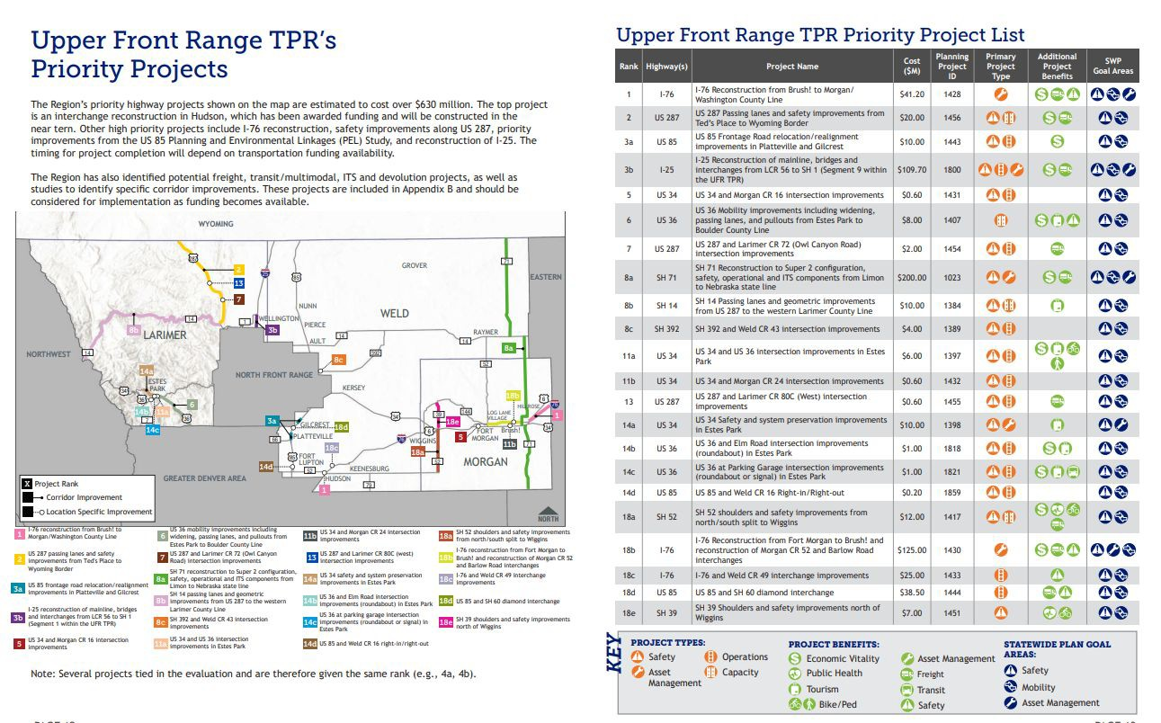
2045 RTP Priority Projects
Under Construction
(I-76 is partially funded)
Funded (US 287 projects are combined as a single project)
In Design
30

Slide 48
2050 RTP PROJECT PRIORITIES
31

Slide 49
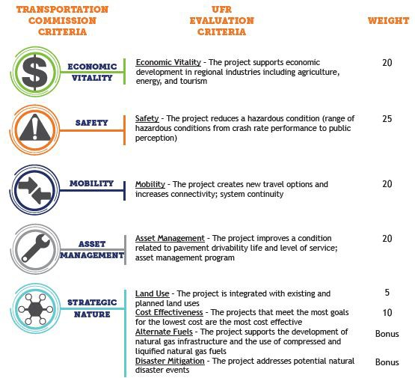
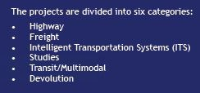
UFR Project Scoring (from 2045 RTP)
Only the Highway projects were evaluated using the scoring guidelines.

Slide 50
Discussion Question: Project Evaluation
Approach for 2050 RTP
Do you want to retain the same approach for project evaluation as last time? Or, is there a desire to change any of the evaluation criteria, weighting and/or apply updated data to assess the projects?
  Last time, we only scored the new projects. If the highway project scoring criteria is updated, we would likely need to rescore all the projects (holding harmless the projects that have already been funded or are in design).
Last time, the TPR only scored highway projects. Does the TPR want to look into a data-informed approach for scoring transit projects?
  May want to consider different approaches for local vs regional & inter-regional transit needs.
How would the TPR like to consider new projects to be added to the list?

Slide 51
Summary of TPR Decisions & Guidance
Approach to identifying project priorities:
Who is responsible:
Evaluation categories:
Projects to be evaluated:

Slide 52
SCHEDULE & NEXT STEPS
35

Slide 53
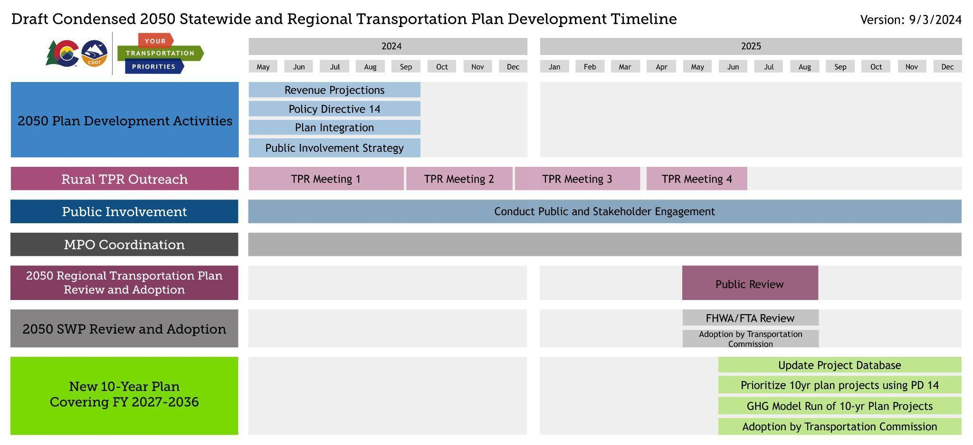
2050 Statewide and Regional Plan Timeline
36

Slide 54
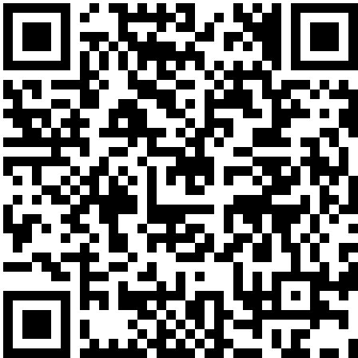
Next Steps
Meeting # 3 (Winter 2024-25)
  Summarize & discussion of public input
  Present and discuss draft project priorities
Virtual Town Hall with TC Commissioner (Winter 2025)
Meeting # 4 (Spring 2025)
  Review draft RTPs
TPR Chair Meeting (Spring / Summer 2025)
Check Out the ‘Your Transportation Priorities’ Website for More Information

Slide 55
Upper Front Range TPR
Active Transportation/Transit Session
December 5, 2024
38

Slide 56
Meeting Purpose
Bring forward the best possible projects in Upper Front Range TPR
Review benefits of active transportation and transit
Provide an update on current CDOT led active transportation and transit initiatives and correlation to RTP update and implementation
Discuss importance of intentional integration of active transportation and transit projects with roadway, safety, maintenance projects
Identify opportunities for project integration
39

Slide 57
Importance of “Complete Project” Approach
57

Slide 58
Project Integration Approach
Complete projects consider the needs of people and places and use context-sensitive solutions to improve access, mobility, and safety
Complete projects often, but not always, integrate multiple travel modes
Projects designed as “Complete Projects” are more comprehensive in addressing diverse needs, making them more compelling for future funding opportunities.
Identifying needs early on helps secure appropriate funding
58

Slide 59




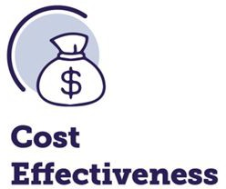


“Complete Project” Considerations
Focus on the needs and experiences of all users; equitable access to transportation options
Prioritize the safety of everyone using the transportation system
Balance costs with benefits delivered; identify solutions that provide the best value
Ensure safe, accessible streets for everyone—whether they walk, bike, drive, or take transit
Plan for current and future transportation needs, considering changes in population, technology, and land use
Fit the local community and environment using context-sensitive solutions that respect the character, culture, and environment of the area
Provide efficient and reliable travel across all modes of transportation
59

Slide 60
Active Transportation
60

Slide 61
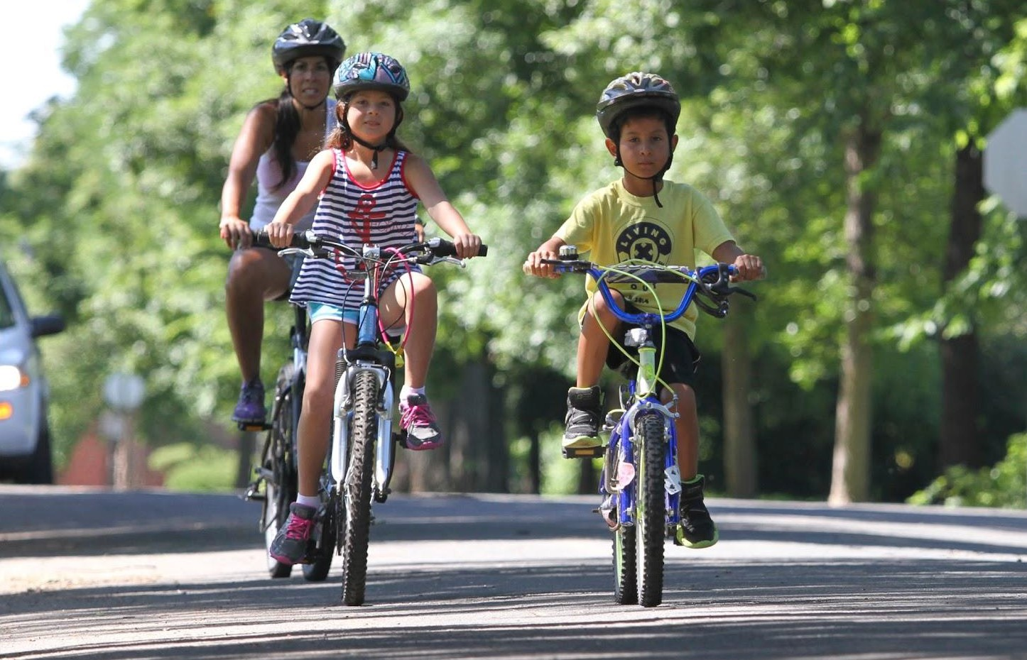
What is Active Transportation?
Active transportation is any human-scale and typically human-powered mode of transportation, such as walking, running, bicycling, roller blading, or using an electric bicycle, kick scooter or electric scooter, skateboard, wheelchair, or other personal assistive mobility device.

Slide 62
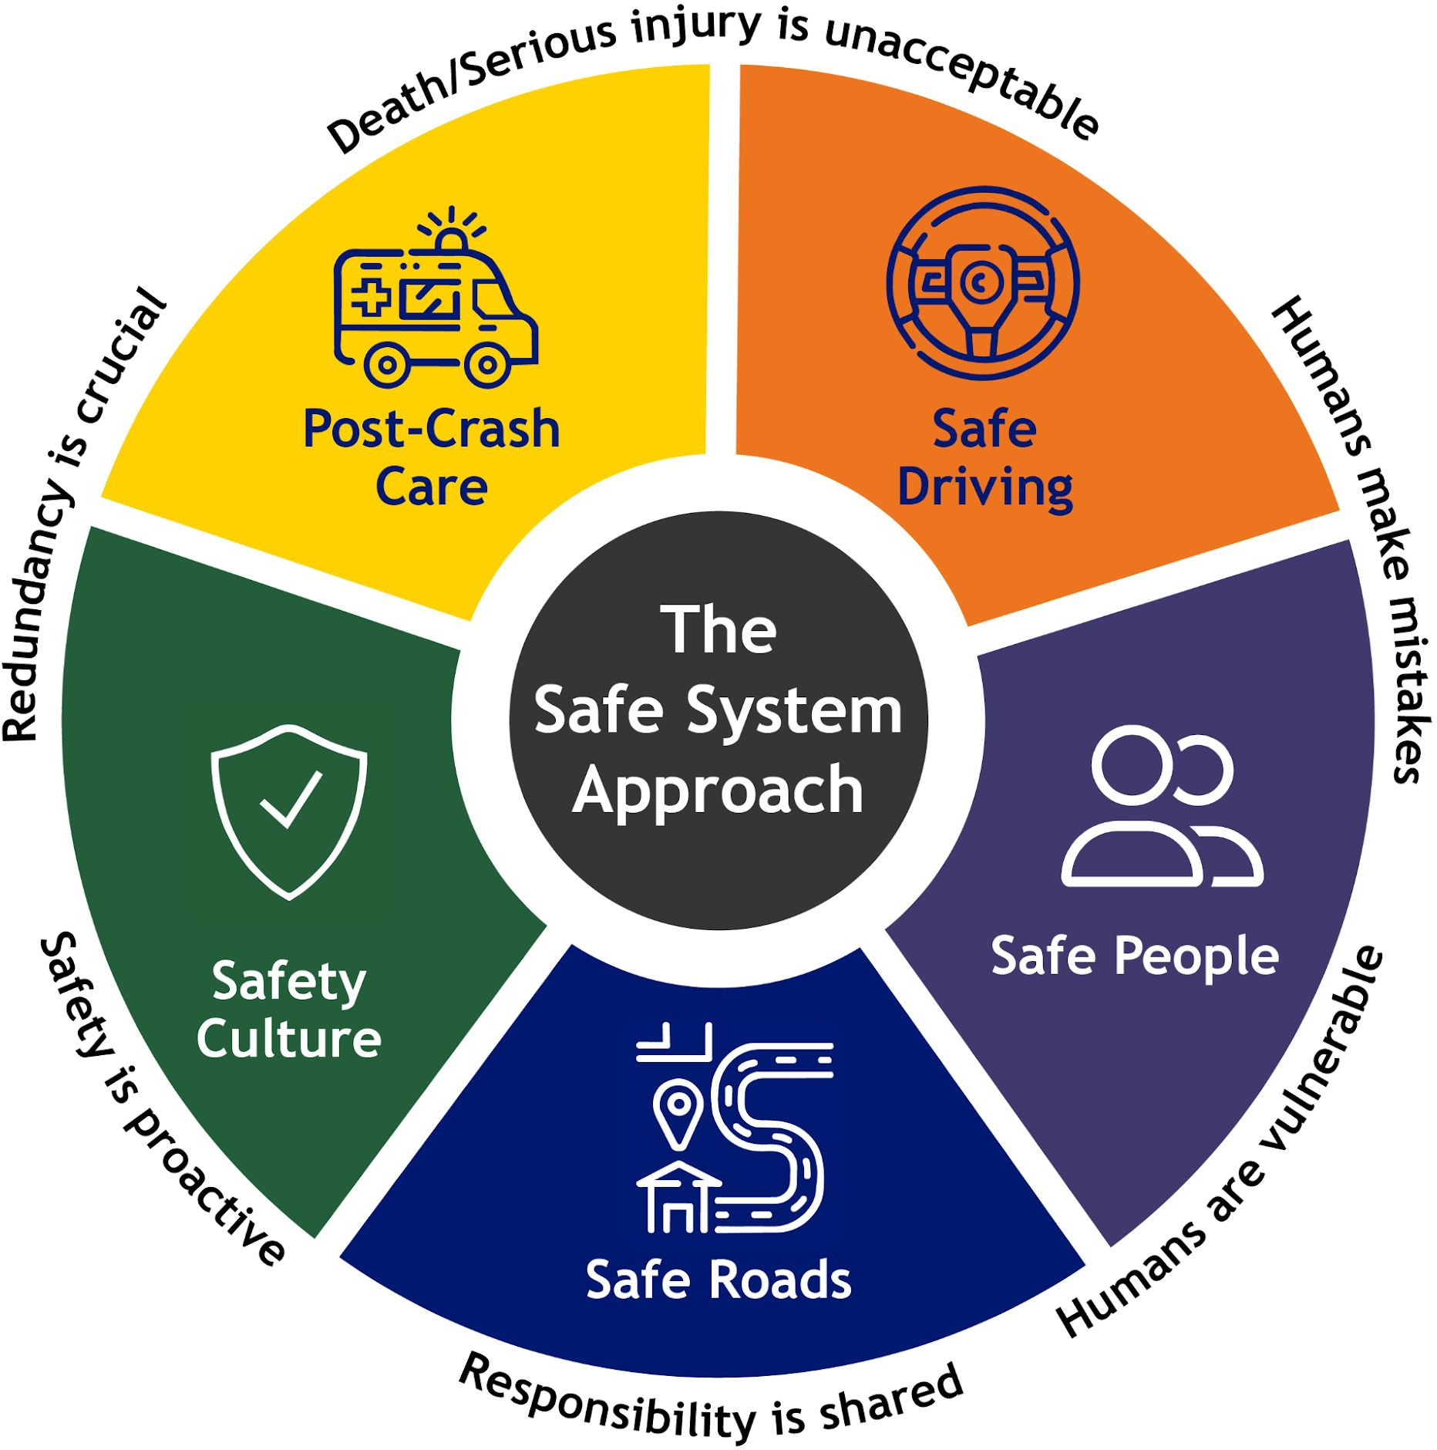
What is a Vulnerable Road User (VRU)?
Vulnerable Road Users include:
  Pedestrians
  Cyclists (including those on e-bikes)
  People using personal mobility devices (e.g. wheelchairs)
  People using rideable toys (e.g. scooters, skateboards)
  People working in roadway work zones

Slide 63
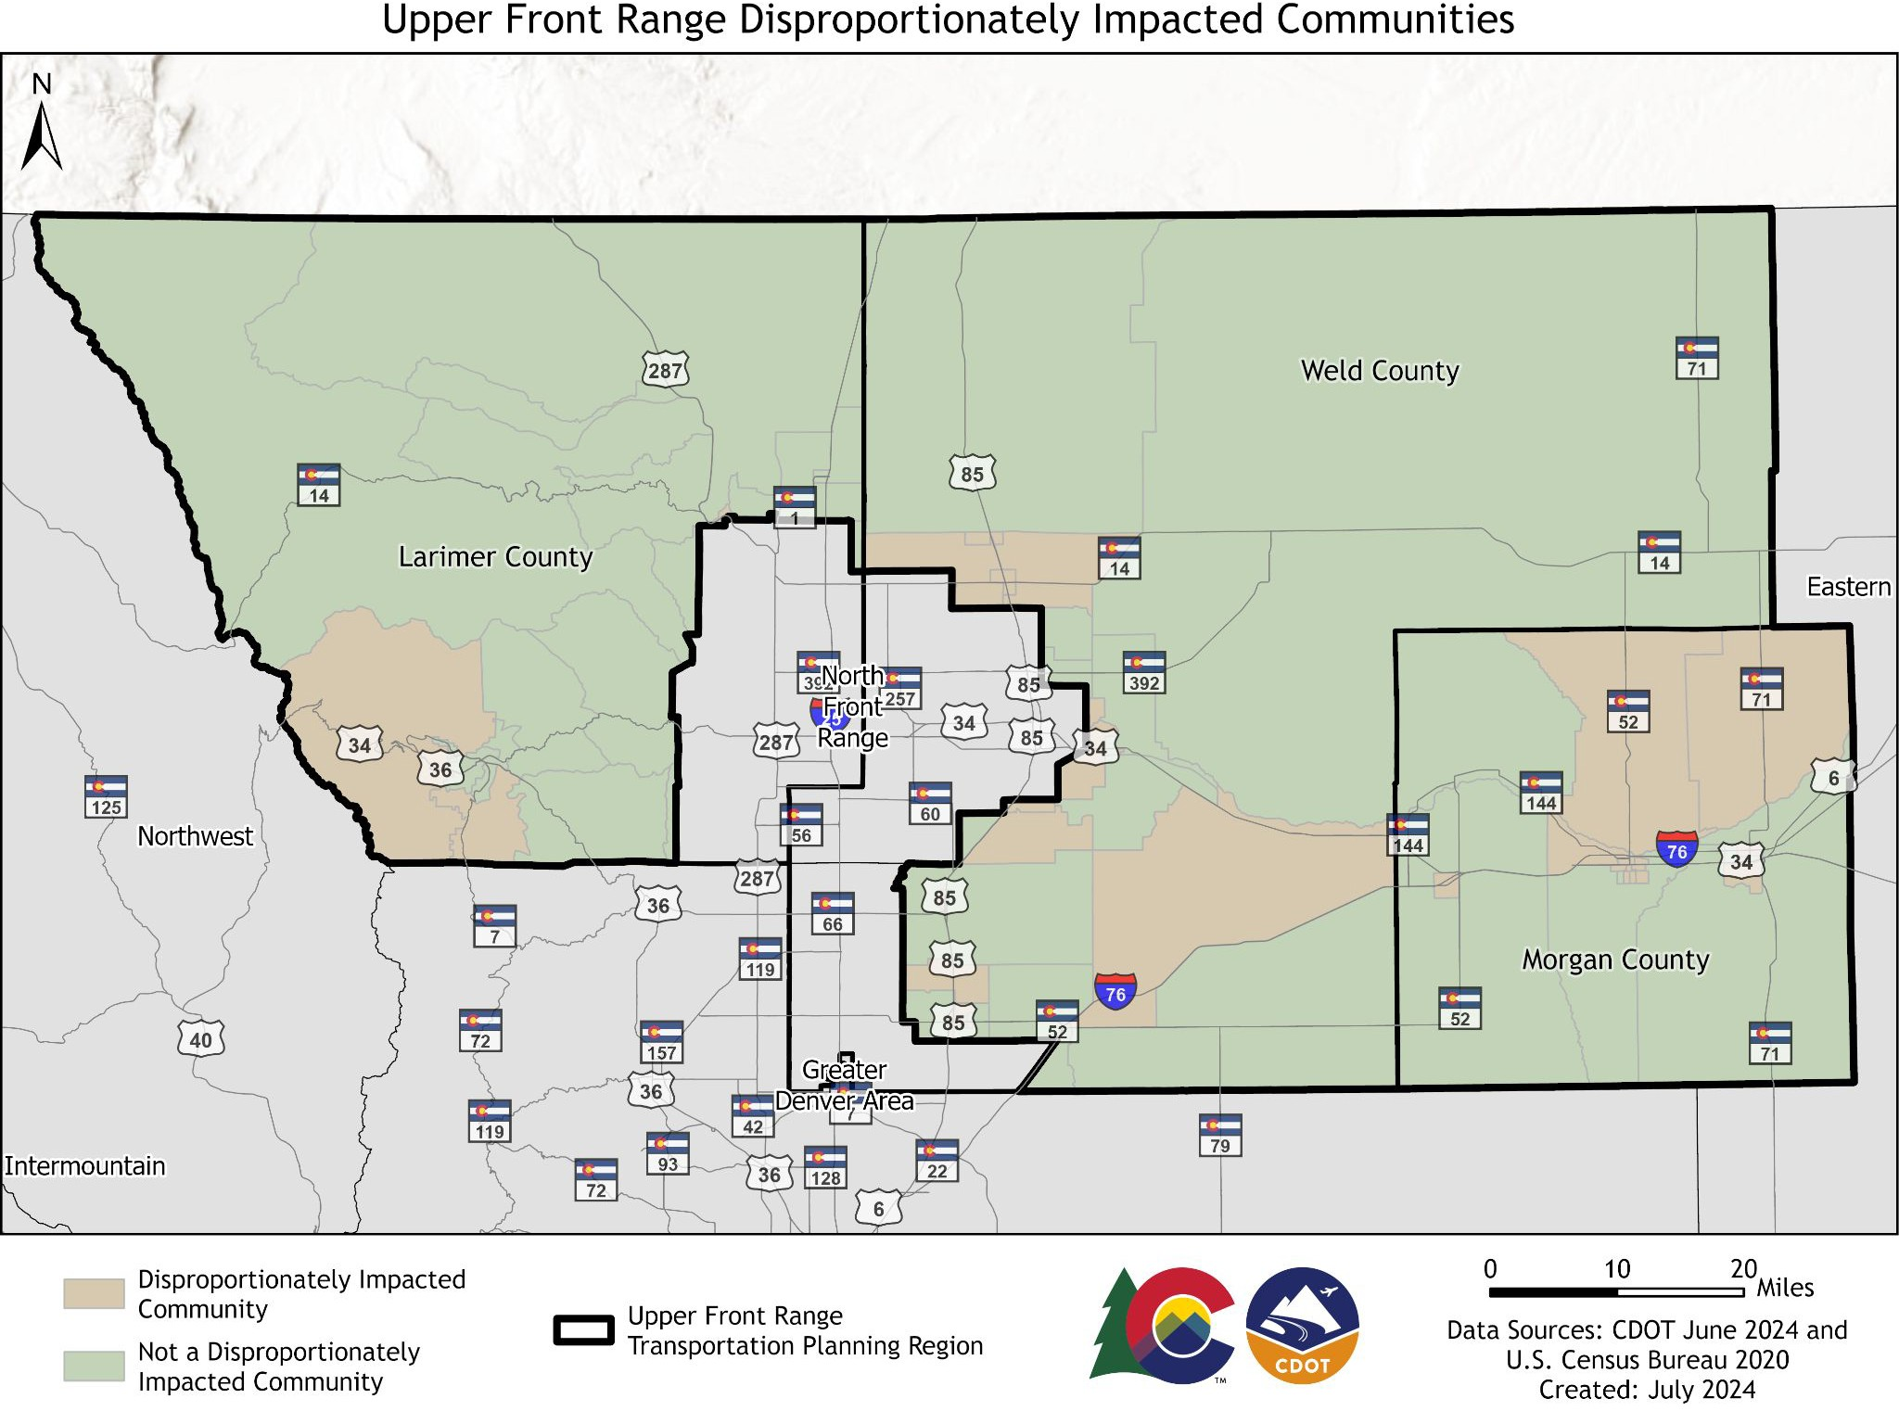
^{DI Communities meet one}W^{or} hat are Disproportionately Impacted (DI)
more of the following criteria:
Communities?
Low Income - 40% or more are below 200% of the federal poverty level
Housing Cost Burdened - 50% or more spend over 30% of household income on housing
Communities of Color - 40% or more identify as people of color
Linguistic Isolation - 20% or more speak a language other than English and speaks English less than very well
Historically Marginalized – History of environmental racism, such as redlining
Cumulative Impact – Justice40 or ES80
Tribal Lands
Mobile Home Parks

Slide 64
Why Invest in Active Transportation?
*Policy Directive (PD) 14
Goal Areas
* Safety *
* Sustainably Increase Transportation Choice *
Economic Growth
Community Connections
Equity
Public Health

Slide 65
Why Invest in Active Transportation?
* Safety *
600+ VRUs seriously injured or killed each year in Colorado, an 80% increase from 2013
* Sustainably Increase Transportation Choice *
Transportation causes 28-30% of all GHG emissions
Travel options provide choice
*Policy Directive (PD) 14
Goal Areas
Economic Growth
Contributes
$1.5B+ annually to Colorado’s economy
Community Connections
Human-scaled transportation supports placemaking
Equity VRU crashes occur 2x more
often in DI communities
Public Health
Increase physical activity, promote mental health

Slide 66
CDOT-Managed Grant Programs
RMS – Revitalizing Main Streets
MMOF – Multimodal Transportation &
How to Fund Active Transportation
Mitigation Options Fund (awarded by TPRs)
SRTS – Safe Routes to School
TAP – Transportation Alternatives Program
HSIP – Highway Safety Improvement Program
USDOT-Managed Grant Programs
ATIIP - Active Transportation Infrastructure Investment Program
SS4A – Safe Streets and Roads for All
RAISE - Rebuilding American Infrastructure with Sustainability and Equity
RCP - Reconnecting Communities Pilot
Other State Agencies
GOCO – Great Outdoors Colorado
CDPHE’s Demonstration Project Funding
DOLA’s EIAF - Energy/Mineral Impact Assistance Fund Grant
As part of highway projects
10-year plan fund sources
Resource: USDOT Pedestrian and Bicycle Funding Opportunities Table

Slide 67
What makes a good location for AT investment?
Unmet and existing demand for active transportation
  Near schools, parks, main streets, or residences
Closes a network gap
Enhances safety at location where VRU crash(es) or near miss(es) have occurred
Within 1-mile of existing or planned transit stop
Serves a Disproportionately Impacted (DI) community

Slide 68
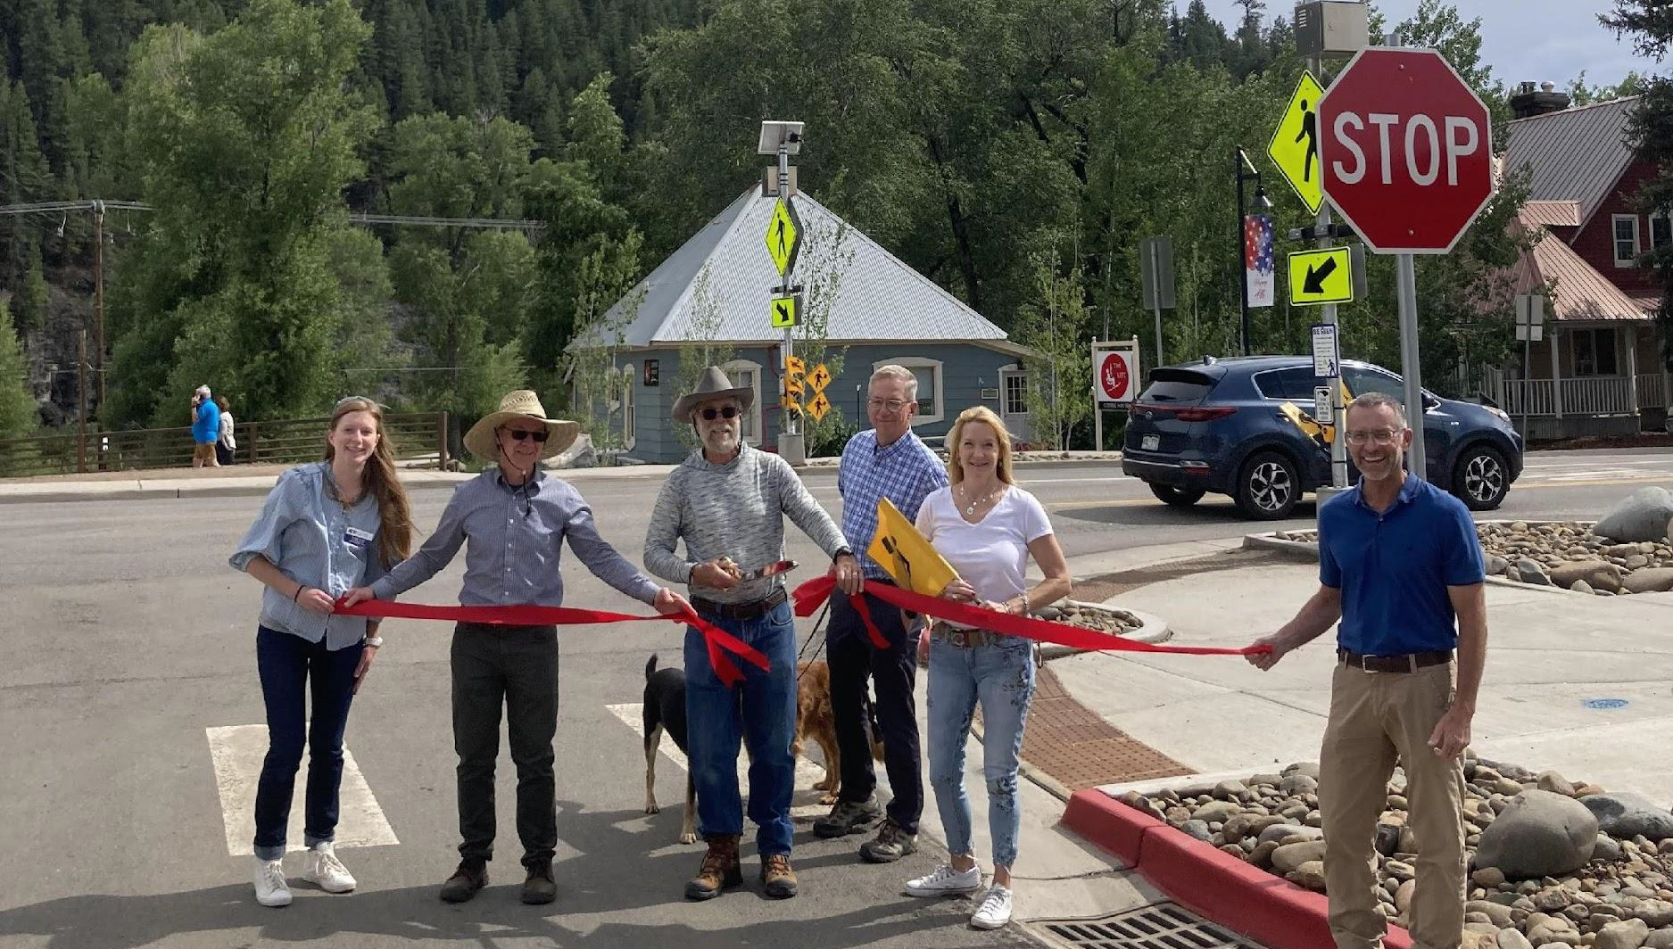
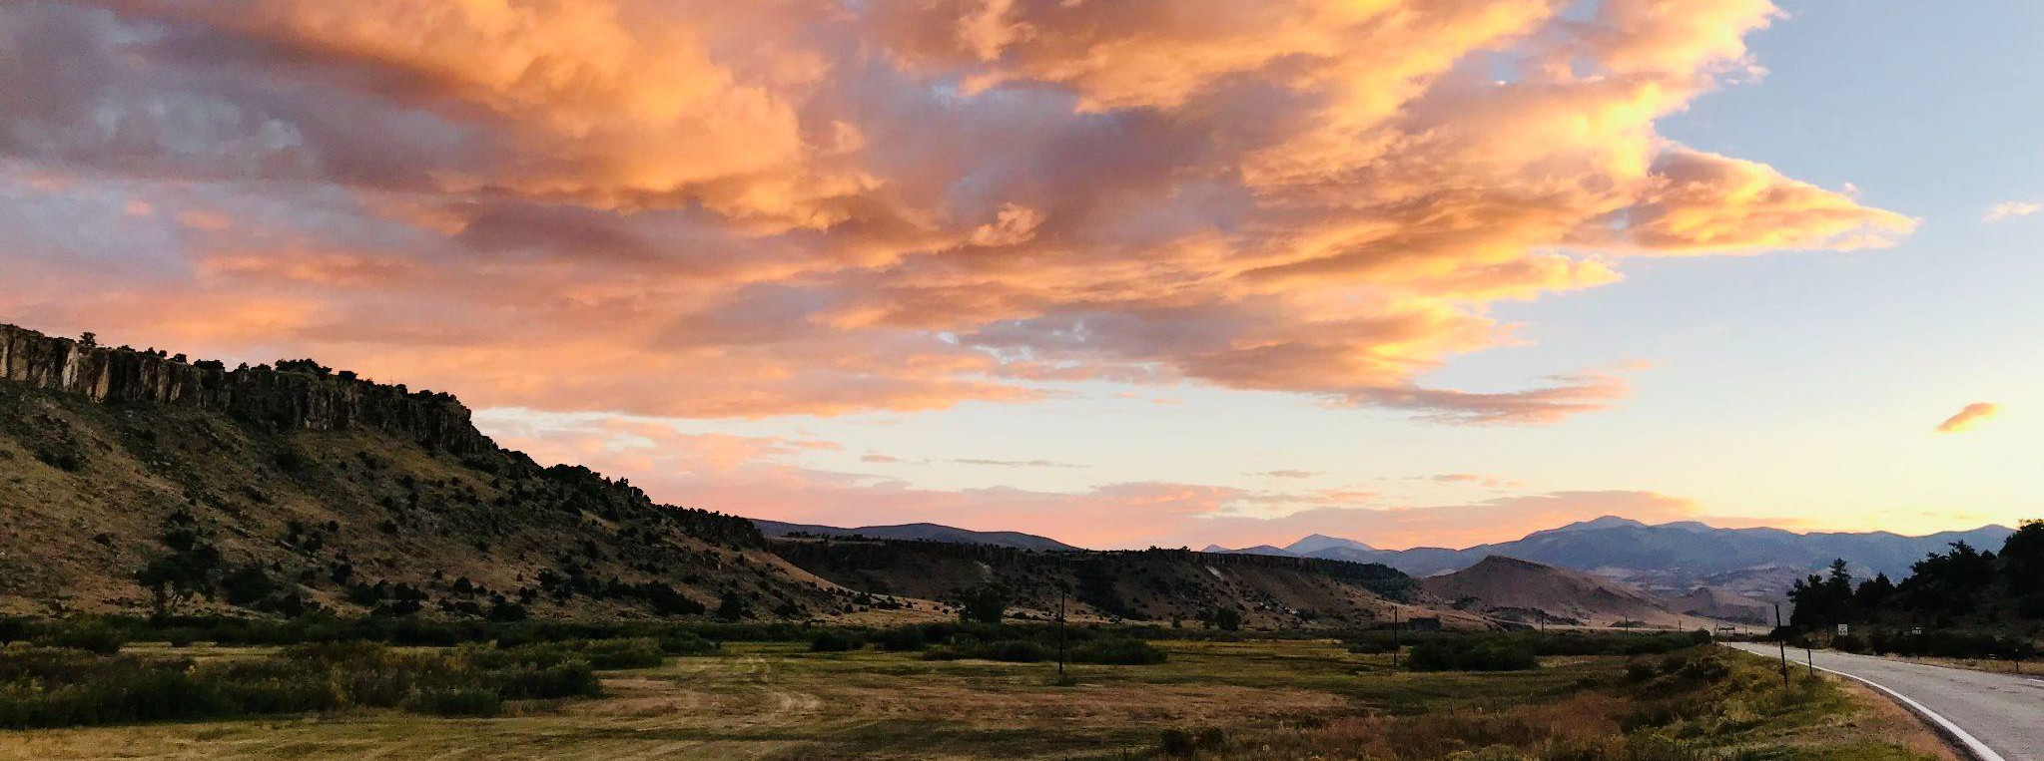
Active Transportation Plan
(ATP) Overview
51

Slide 69
Active Transportation Plan (ATP)
Set goals, policy recommendations, and action steps
Integrate with local and regional bicycle and pedestrian plans
Create tool to prioritize active transportation investments/priorities
Integrate with other statewide planning initiatives
Not a project-based plan

Slide 70
DRAFT Active Transportation Goals
SAFETY: Enhance the safety of active transportation users by reducing crashes, injuries, and fatalities.
EQUITY: Ensure equitable access to safe and convenient active transportation facilities for all communities, particularly underserved and vulnerable populations.
MOBILITY CHOICE: Increase the availability, accessibility, and convenience of active transportation to create a complete network that provides sustainable alternatives to driving and improves air quality.
CONNECTED COMMUNITIES: Promote connections among active transportation, transit, and the built environment to maximize the impact of investments in active transportation infrastructure and programs.

Slide 71
ATP Public Involvement
Phase I: Public survey on active transportation activity, barriers, facility preferences, and vision
Phase 2: Vision, goals and strategies
Phase 3: Implementation Plan
Statewide Community Advisory Committee
  Consists of local and state agency representatives, MPO and TPR representatives, and bicycle and pedestrian advocates
  Will meet 2 more times between now and April 2025 (first meeting was Sept 25)
  To join, email Annelies at annelies.vanvonno@state.co.us

Slide 72




ATP Survey Results
55

Slide 73
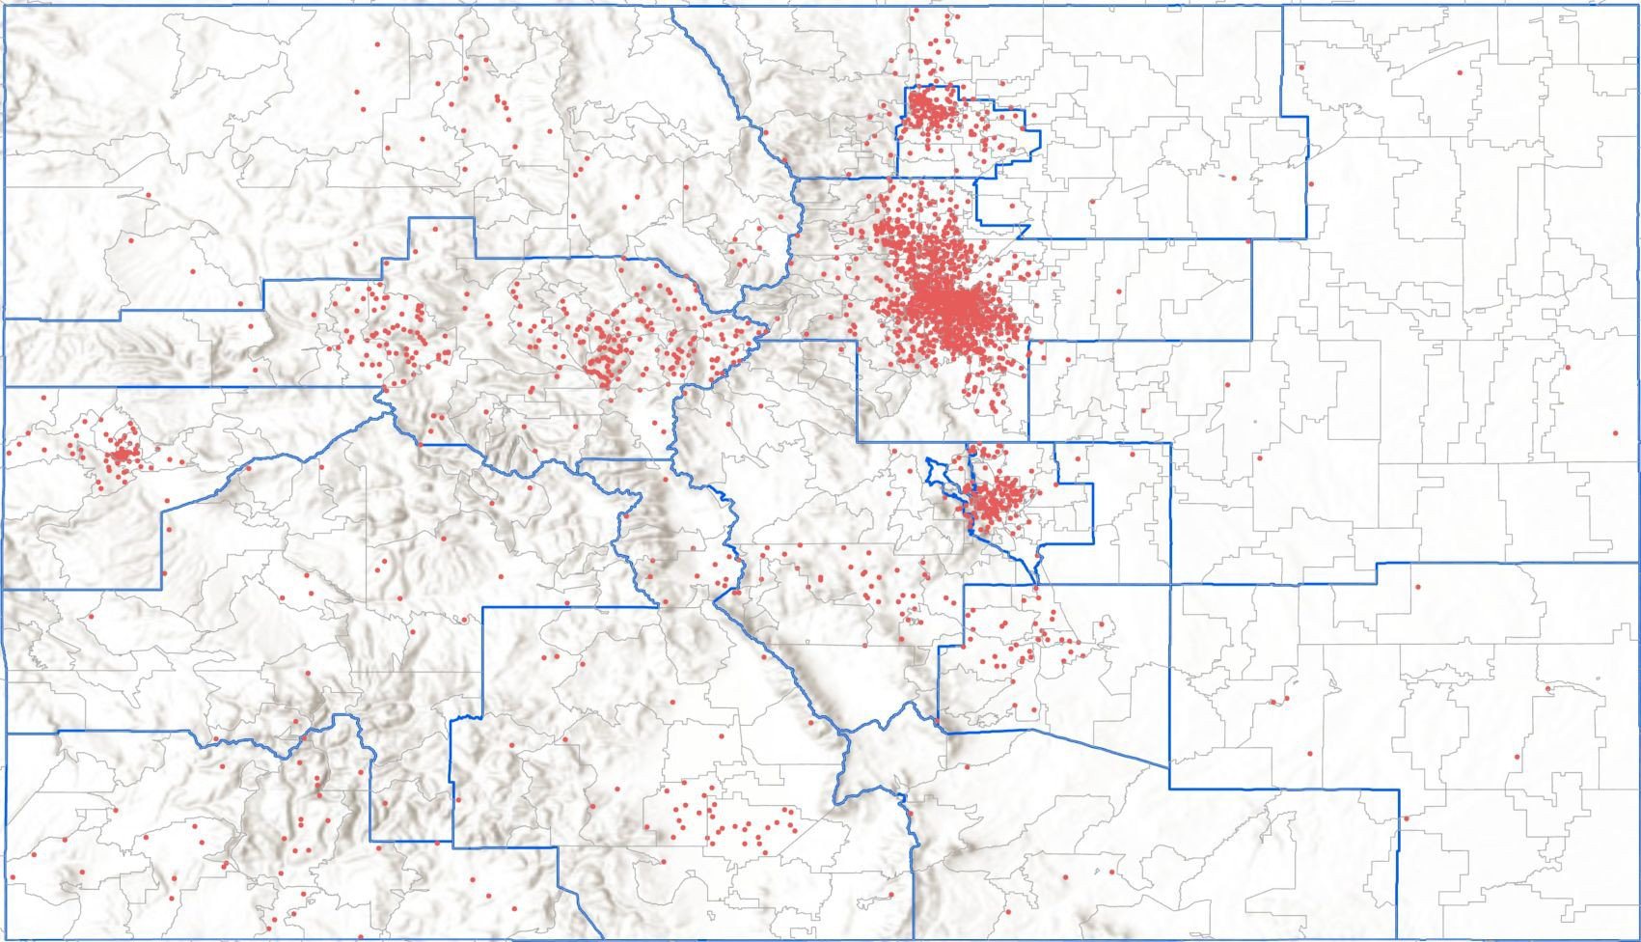



ATP Survey Responses
Northwest
Upper Front Range
3,099 respondents statewide
North Front Range
Denver Area
55 respondents in the Upper Front Range TPR
Intermountain
Eastern
Grand Valley
Central Front Range
Pikes Peak Area
Gunnison Valley
Pueblo Area
San Luis Valley
Southeast
Southwest
South Central

Slide 74
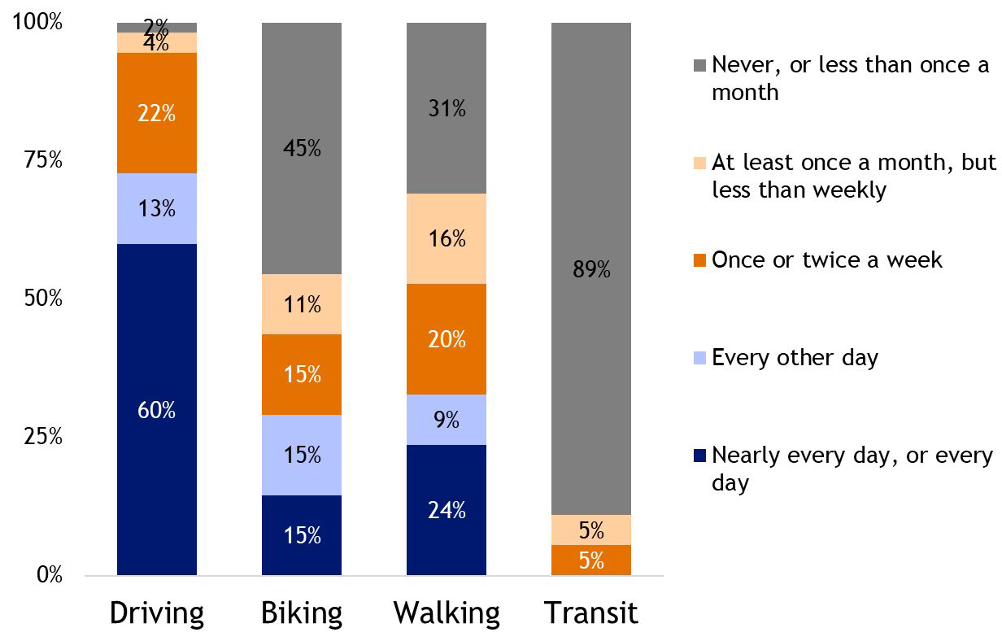
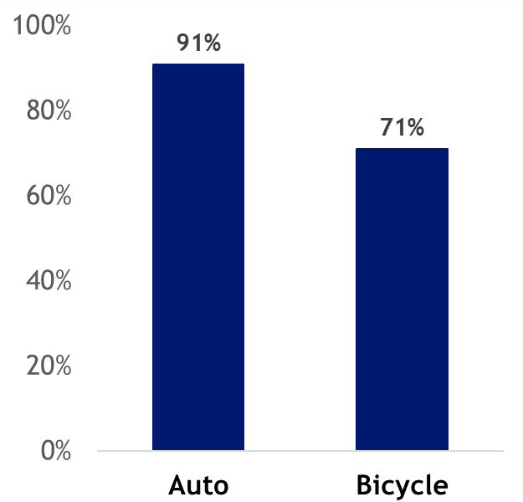
UFR Survey Results: Vehicles and Modes
Vehicle Access
Travel Modes

Slide 75
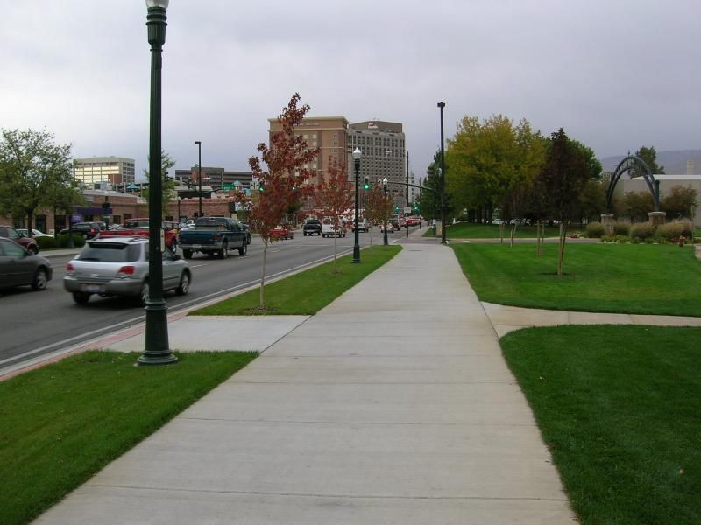
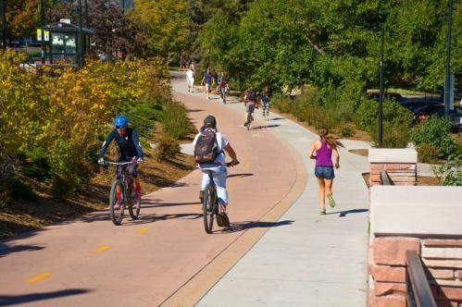
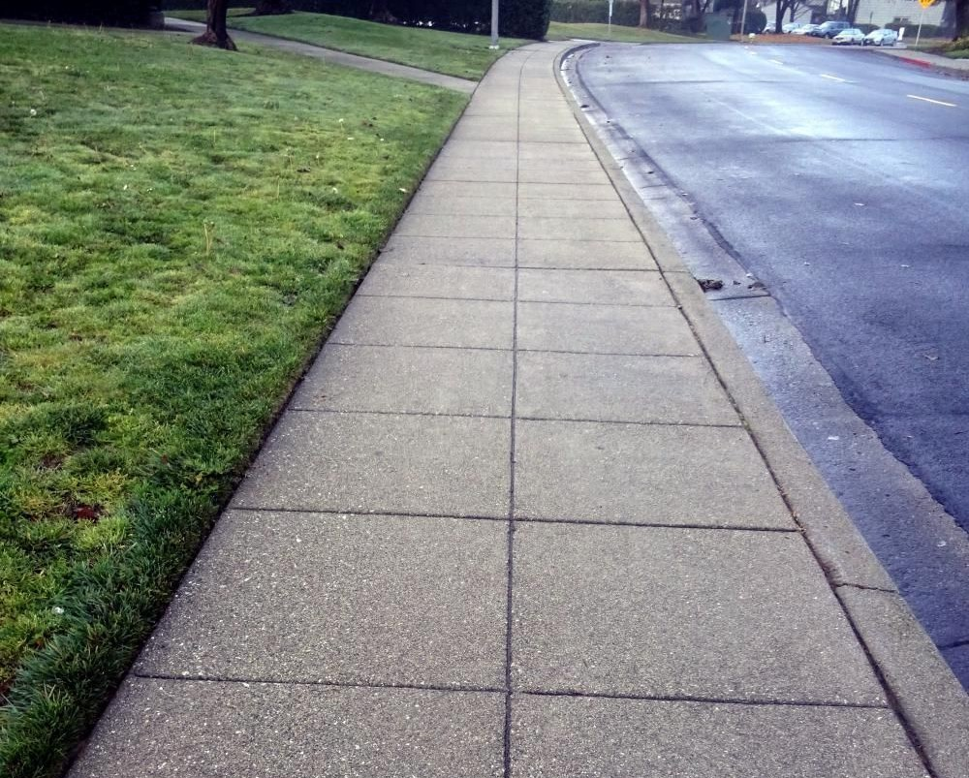
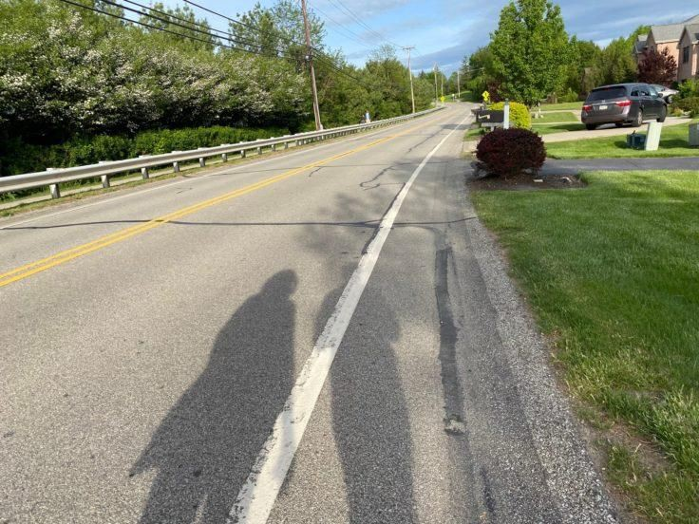
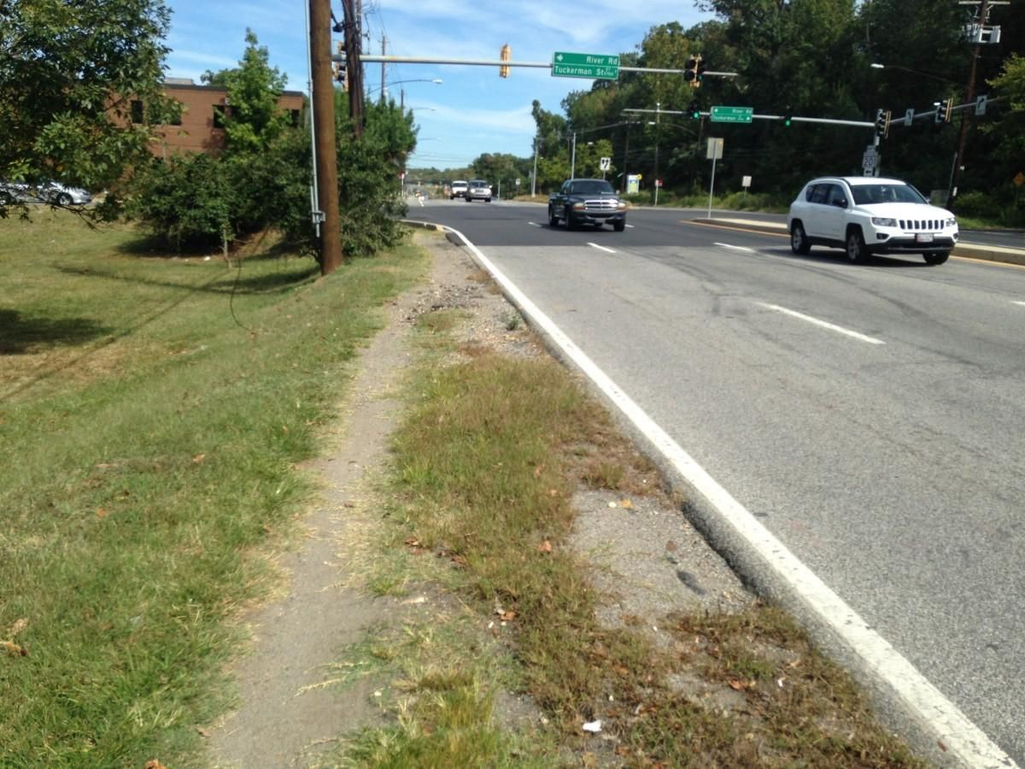
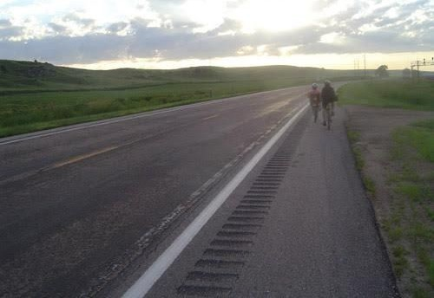
UFR Survey Results: Pedestrian Facilities
Percentage of respondents confident or comfortable:
100%
78%
84%
Detached sidewalk on a
Multi-use path
residential road
Narrow sidewalk, next to road
9%
11%
4%
Shoulder & available grass
No shoulder, available grass
58
on a residential road
on a residential road
Highway with shoulder

Slide 76
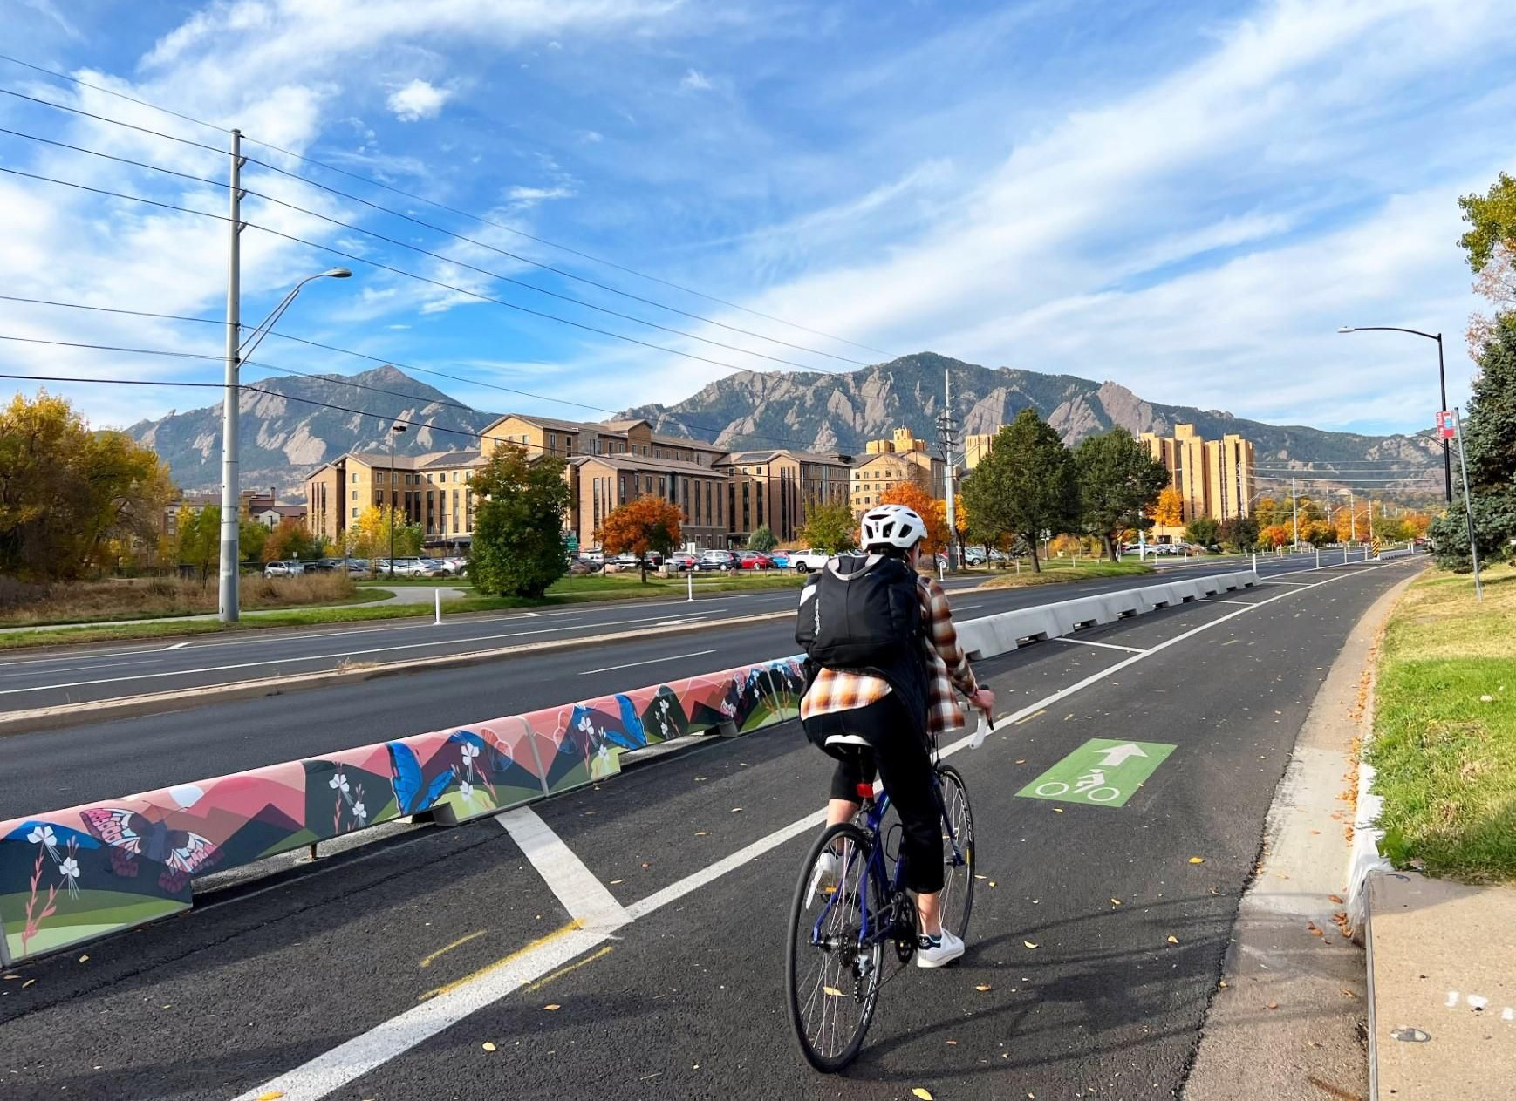
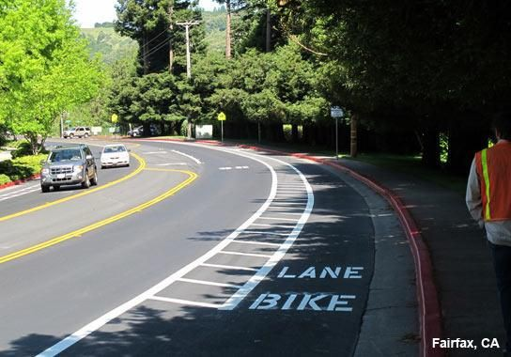
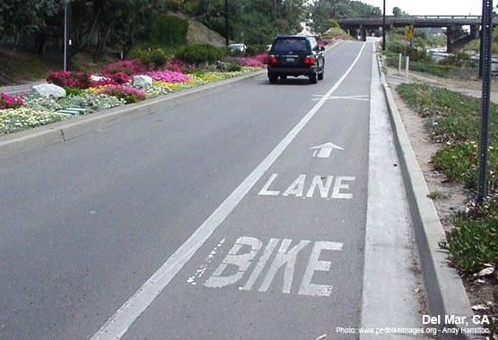
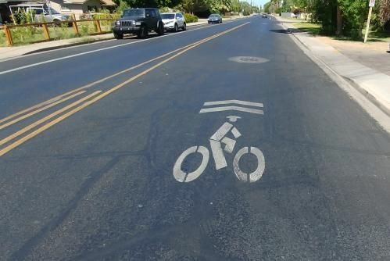
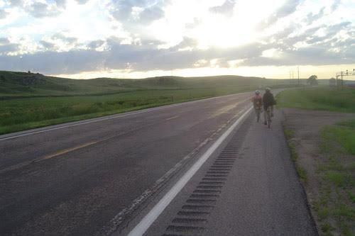
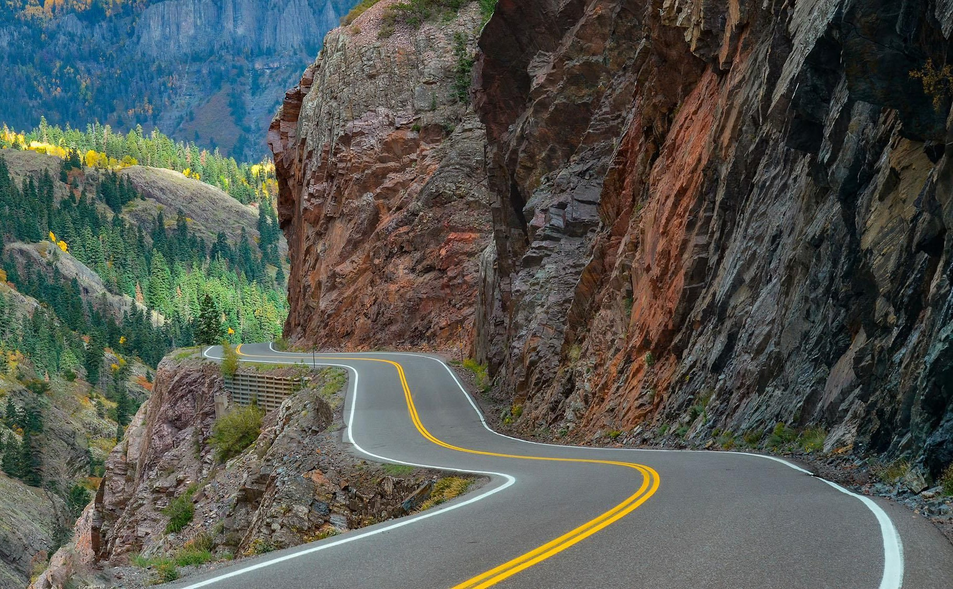
UFR Survey Results: Bicycle Facilities
Percentage of respondents confident or comfortable:
94%
85% 72%
55%
Multi-use path
Bike lane with physical protection
Buffered bike lane
Bike lane with no buffer or barrier
38%
11%
2%
Sharrow on a residential road
Highway with shoulder
Highway with no shoulder

Slide 77
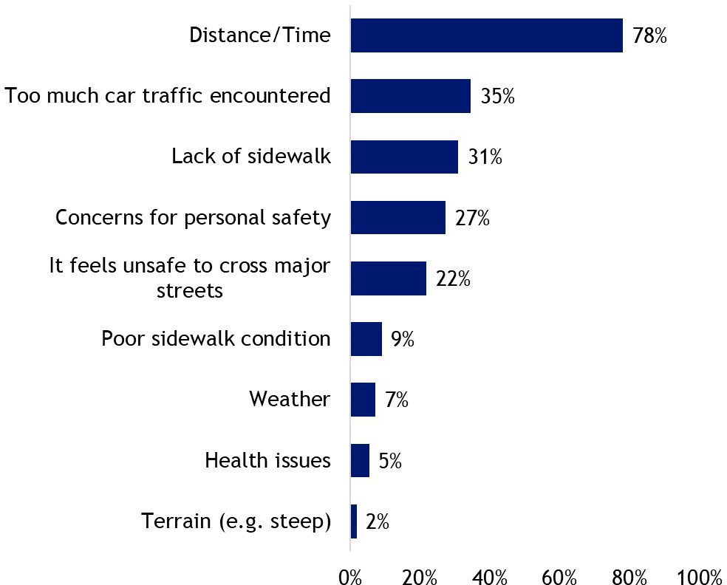
UFR Survey Results: Barriers to Walking

Slide 78
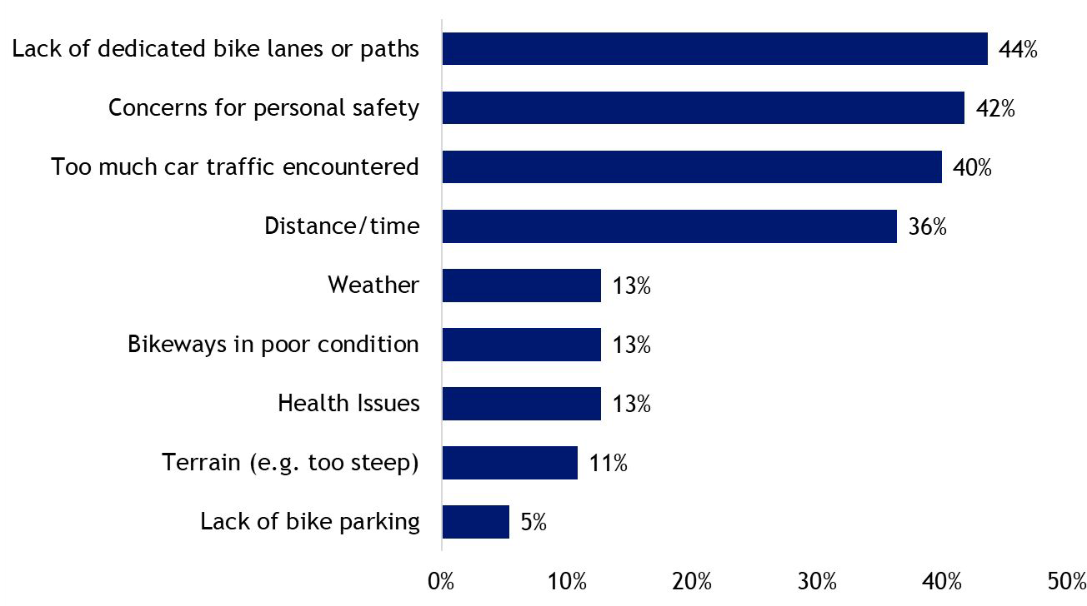
UFR Survey Results: Barriers to Biking and Rolling

Slide 79
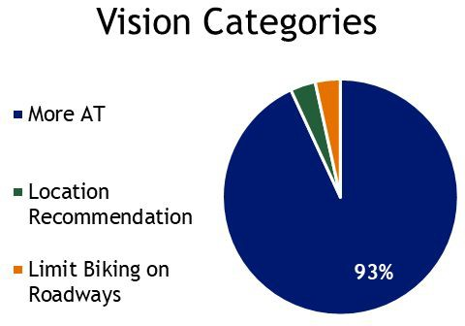
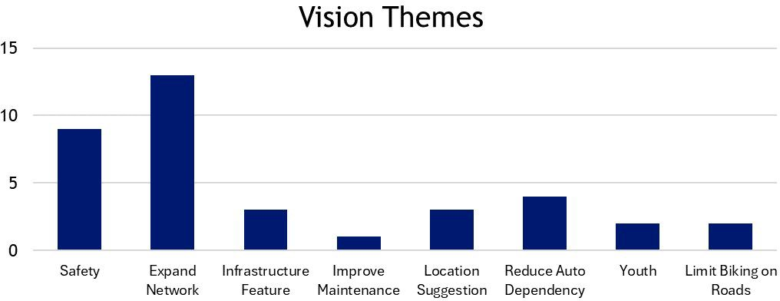
UFR Survey Results: Active Transportation Vision
“Protected bike lanes on major roads; not having to bike more than 0.5 miles unprotected”
“More communities in Northern Colorado east of US 85 connected by bike paths.”

Slide 80
Transit
Regional Transit, TCS, & Complete Transit Projects
63

Slide 81
Setting the Stage
Upper Front Range’s Transit Vision (2019)
To improve regional mobility for all residents through effective coordination, planning, and delivery of transit services.
Statewide Transit Goals
Mobility
A modally integrated transit system that provides local, regional, and interregional connectivity and is affordable, efficient, and easy to use.
Safety
A resilient transit network that makes travelers feel safe and secure.
Asset Management A high-quality system that is financially sustainable and operates in a state of good repair.

Slide 82
Advancing Priorities through Transit
Benefits of Transit
Connectivity
Accessibility
Affordability
Travel choice
Reduced congestion
Reduced air pollution
Improves public health and quality of life
Transportation Focus Areas
Make travel safer
Fix our roads and maintain our current system
Expand transit service to Coloradans
Reduce GHG emissions from the transportation sector
Advancing Transit
Planning & Promoting
Prioritizing
Funding
Implementing

Slide 83
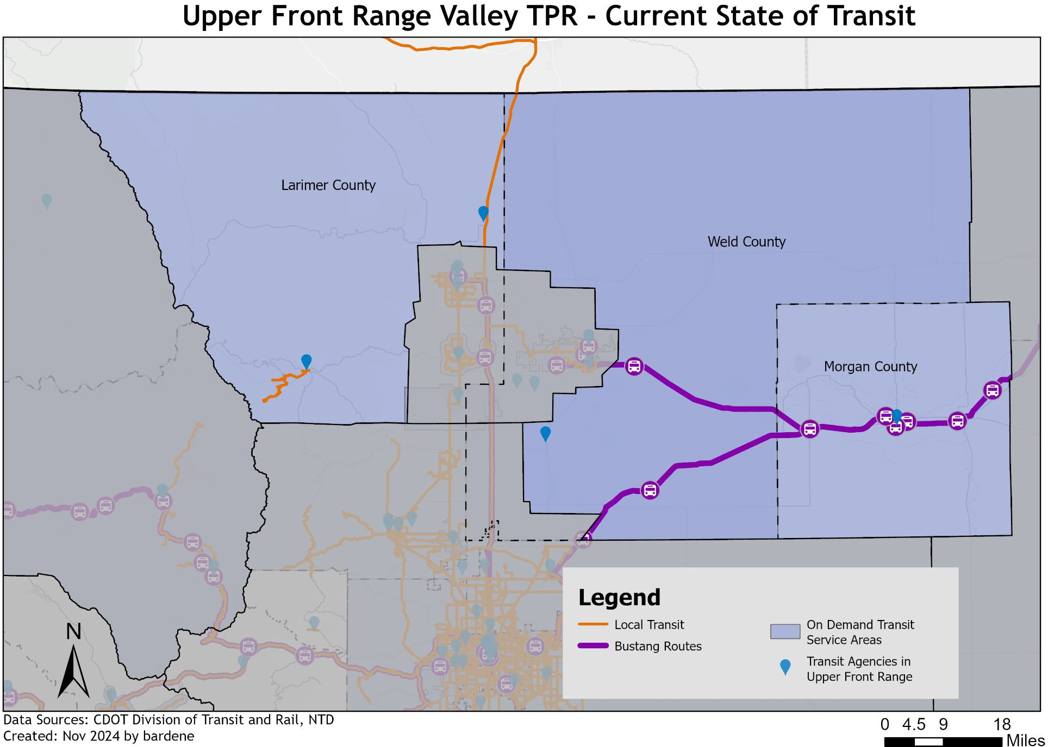
Transit in Upper Front Range
Transit Providers
NECALG
Estes Park
Via Mobility
Transfort

Slide 84
Transit in Upper Front Range
Existing Transit in the Upper Front Range
Estes Park - Providing local transit services and connections to RMNP
NECALG - County Express operates on-demand transit and fixed route services in Morgan county as well as Northeast counties in Eastern TPR
Transfort - Working to provide connections from North Front Range
Via Mobility - providing on-demand transit in Larimer and Weld counties
North Front Range MPO (RideNoCo) - Provides a call center in Larimer and Weld County, coordinating human service and transit services

Slide 85
Transit in the Regional Plans
Planning Requirements for Transit
Regional Transit Plans serve as the Regional Coordinated Transit and Human Services Plans that meet FTA requirements for On Demand Transit Providers to receive funding (23 CFR Part 450; 49 CFR Part 613).
  CDOT will get the information in the Transit Provider Survey (expected early 2025) and this information needs to be in the RTP appendix
  Infrastructure projects are required to be in a plan to receive federal funds
  Upper Front Range’s previous Coordinated HST Plan for example

Slide 86
Transit in the Regional/Statewide Plans
Planning Process
  Updating previous Regional/Statewide Plan
    Have needs, conditions, or priorities changed?
    Keep in mind - who will be running this project and are they prepared for it?
    Is there a financial plan for sustainable funding? Does it need to be updated?
    Are projects outdated and/or should they be removed from the plan?
Adding projects to this upcoming plan - please let us know
Examples
  Projects scope could change within reasonable bounds to add a feasibility study or design
  Lead Agency could be changed
SB24-230 and additional transit funding opportunities - including competitive grants

Slide 87

Regional Plans & TCS
Regional Transportation Plan
The Regional Plan provides input in the Region’s priorities for projects
This is where Upper Front Range’s insight & priorities informs statewide planning
Transit Connections Study
  TCS will not provide recommendations; it will serve as a resource for transit agencies & CDOT
  Ex. How does Bustang/Outrider fit into Colorado’s transit? How might CDOT improve it?

Slide 88
Examples of Transit Project Integration:
“Complete Project”
Projects that involve transit or incorporate transit into the process
Examples for Upper Front Range RTP -
Complete Project Ideas
Corridor Studies | Corridors with heavy bus usage: how does this impact road condition? High traffic areas: could transit alleviate some car traffic?
Road Improvements | Bus Bays - Moving Transit stops away from flowing traffic Reinforcing Bus Stop areas with concrete

Slide 89
Next Steps
72

Slide 90
Key Takeaways
There is funding for active transportation and transit that cannot go to other types of projects.
Integrating active transportation and transit elements into roadway, safety and maintenance projects where feasible can make projects more competitive for 10-Year Plan funding (in terms of GHG compliance and PD 14 evaluation), and other sources of discretionary funding.
As you as a TPR work to update your priority project list and database of projects, TPR members are encouraged to work with your regional partners and transit agencies to bring forward active transportation, transit, and “complete project” ideas.
73

Slide 91

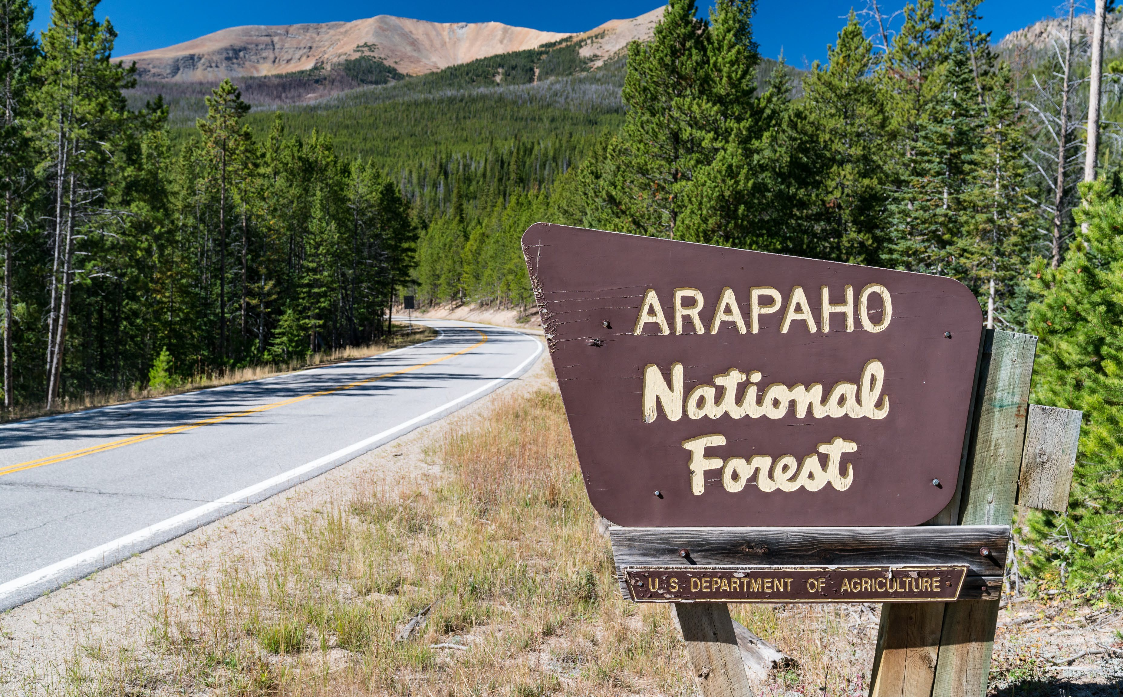







Colorado Multi-Agency Planning
Briefing for Upper Front Range TPR
December 5, 2024
CENTRAL FEDERAL LANDS HIGHWAY DIVISION
Planning, Programming & Environment
Andrew Valdez, Planning Team Lead
Arapaho-Roosevelt NF

Slide 92

Project Briefing & Update
Project Purpose: Central Federal Lands (FHWA) is working with CDOT to update federal lands access sections of the state’s Transportation Planning Region (TPR) long-range plans.
Larimer County hosted a multi-agency workshop on November 15th
In attendance were representatives from: NPS, USFS, CDOT, Larimer County, North Front Range MPO,Weld County, Bureau of Reclamation, and Colorado Parks & Wildlife.
FLMA access project list from 2020 was refreshed, 12 (fiscally unconstrained) projects have been identified and will be included in CFL’s write up for the TPR & CDOT.
Project prioritization remains with the TPR and your process, keeping in mind that recreational access projects are inherently different that typical urban, interurban, or suburban routes.

Slide 93
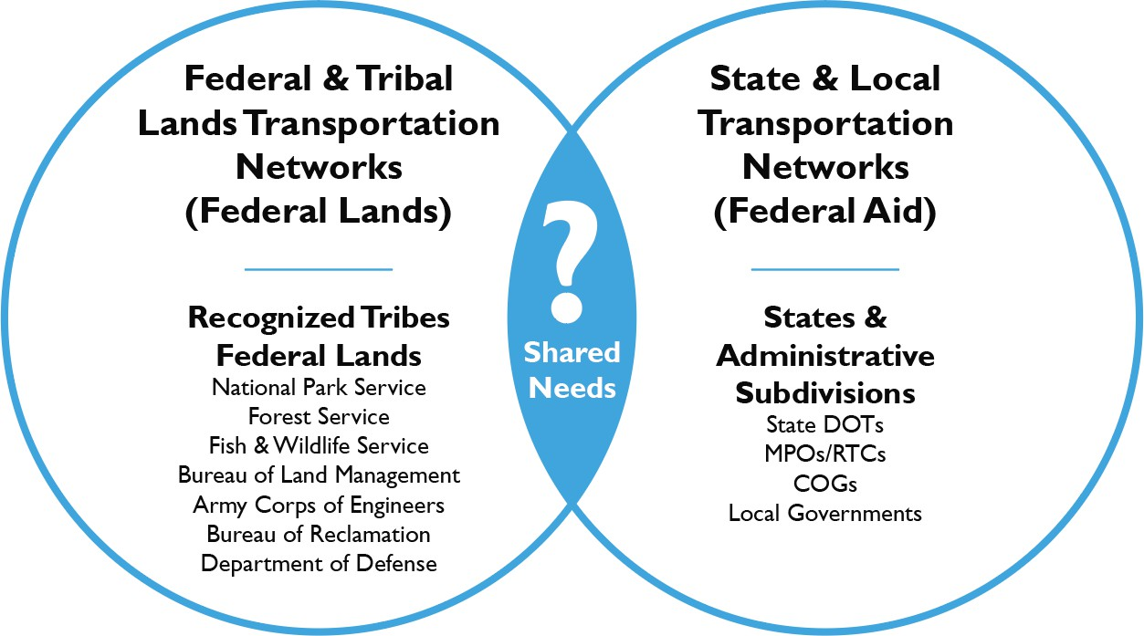

FLMA Coordination
Multi-Agency Workshop: Identify shared needs across federal lands and federal-aid transportation systems through multi-agency planning efforts at the federal, state, MPO, and local levels.
We are looking for projects that are:
Beneficial to multiple agencies and supported by the general public
Most likely to receive (or have received) state or local investment
Projects of mutual interest where planning and design can be aligned before final programming decisions are made
Eligible and competitive for a broad set of state and federal grant funding opportunities (like FLAP, or other discretionary sources at the state or federal levels)

Slide 94
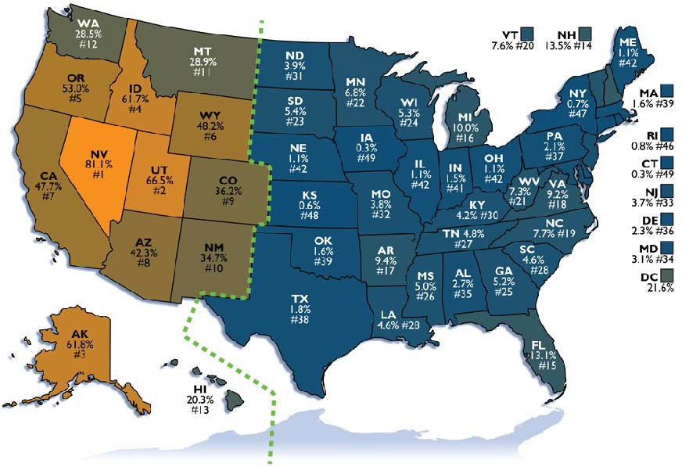
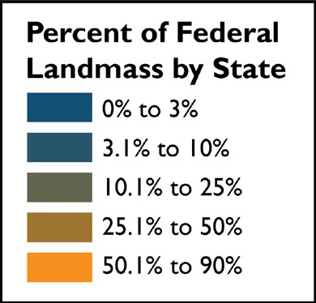
FLAP Funding
Federal Land by State & Funding Allocation
Central Federal Lands States
California
Colorado
Utah
Nevada
Arizona
Wyoming
New Mexico
Texas
Oklahoma
South Dakota
North Dakota
Kansas
Nebraska
Hawaii
$30.7M
$15.9M (2025)
$12.1M
$11.9M
$11.2M
$9.5M
$8.2M
$3.2M
$1.2M
$1.2M
$1M
$766K
$329K
$308K
80% of FLAP
> 1.5% of Federal Land
20% of FLAP
< 1.5% of Federal Land
Fiscal Year | 2022 | 2023 | 2024 | 2025 | 2026 | BIL Total
Authorization | $286 M | $292 M | $297 M | $304 M | $309 M | $1.44 B

Slide 95




FLMA Coordination
GOAL: Better cohesion between the federal lands and federal-aid transportation planning processes.
PROCESS OUTCOMES:
Better definition of local FLMAs role at different stages of the state and local planning process.
PRODUCT OUTCOMES:
•
Provide policy and process recommendations for enhanced integration of federal lands access needs into the statewide and MPO transportation planning processes and identifying supplemental funding.
Cultivate new partnerships to jointly fund and/or deliver projects of mutual interest (either grant pursuits or program funds).
•
NATIONAL FLMA NEEDS INVENTORY (FL-TPG)
STATE & MPO LONG-RANGE PLANS

Slide 96

CDOT TPR Plan Update Schedule

Slide 97

CDOT Transportation Planning Regions
NOTE
that Upper Front Range TPR & North Front Range MPO geographies were combined in the workshop, CFL will work with TPR & MPO representatives to tailor deliverables to each.
What’s the ask?
Please validate the list of projects so CFL can begin work on the final deliverables.

Slide 98

Carter Lake/Horsetooth
Validate:
Geographic Extent
Description
Type of Project

Slide 99

County Rd 63 Bridge
Validate:
Geographic Extent
Description
Type of Project

Slide 100

County Rd 73
Validate:
Geographic Extent
Description
Type of Project

Slide 101

County Rd 86
Validate:
Geographic Extent
Description
Type of Project

Slide 102

County Rd 127
Validate:
Geographic Extent
Description
Type of Project

Slide 103

Dunraven
Validate:
Geographic Extent
Description
Type of Project

Slide 104

Greyrock
Validate:
Geographic Extent
Description
Type of Project

Slide 105

Horsetooth
Validate:
Geographic Extent
Description
Type of Project

Slide 106

Lilly Lake
Validate:
Geographic Extent
Description
Type of Project

Slide 107

Mary’s Lake
Validate:
Geographic Extent
Description
Type of Project

Slide 108

Red Feather
Validate:
Geographic Extent
Description
Type of Project

Slide 109

US-36
Validate:
Geographic Extent
Description
Type of Project

Slide 110

Q&A
Andrew Valdez Planning Team Lead 720-963-3329
andrew.valdez@dot.gov

Slide 111


Slide 112


Colorado Highway 14 Safety Study
Draft Recommendations November 2024

Slide 113


PROJECT GOAL
To improve safety along Colorado Highway (CO) 14 from Larimer County Road 5 to Weld County Road 43. A crash data analysis, travel pattern analysis, Road Safety Audit (RSA), virtual audit, field review, and stakeholder interviews were conducted to inform the recommendations.
N

Slide 114








REAR-END
BROADSIDE
11% of All crashes 14% of KSI crashes
Primarily drivers on minor leg failing to yield right-of-way
APPROACH TURN
11% of All crashes 14% of KSI crashes
Primarily drivers failing to estimate distance of approaching vehicles
29% of All crashes 19% of KSI crashes
Drivers failing to slow down at intersections; potential speeding, distracted, & unaware of upcoming intersections
Sun glare obstructing visibility
Sight distance issues at some intersections
CRASH ANALYSIS
HEAD-ON
4% of All crashes 24% of KSI crashes
90% occurred at non-intersection
locations
71% involved drugs and alcohol
Most drivers traveled into the opposing lane to pass other vehicle(s)
A few lost control of the vehicle
FIXED OBJECTS
13% of All crashes 14% of KSI crashes
80% occurred at non-intersection
locations
Many drivers overcorrected before they lost control and drove off the road
A few were avoiding animals
SIDESWIPE OPPOSITE DIRECTION
4% of All crashes
10% of KSI crashes
All occurred at non-intersection
locations
A few lost control of the vehicle

Slide 115




1ST STAKEHOLDER MEETING (3/7/24) OVERVIEW
TYPES OF ISSUE (Stakeholder Identified)
Fatal crashes
Significant crash locations
Crash locations related to drivers passing and utilizing opposite lane (Head-on & Sideswipes)
Speeding
Blind Spot (Verified in field observation)
Blind Spot (Not verified in field observation and LiDAR analysis)

Slide 116
CORRIDOR-WIDE RECOMMENDATIONS

Slide 117


CORRIDOR-WIDE RECOMMENDATIONS
abowers
2024-11-13 17:05:17
--------------------------------------------
One green dot.
Post it note: " Consider 55 MPH max between I-25 & Ault".
44% going more than 10mph UNDER the speed limit
16% going under the speed limit
30% going the speed limit
7% going over the speed limit
3% going more than 10mph OVER the speed limit
CORRIDOR - WIDE SPEED STU DY
The data indicates many speed-related crashes have occurred along the corridor. A corridor-wide speed study is recommended to determine appropriate speeds and to help identify the appropriate locations for the self- enforcing roadway concepts.
25 MPH
35 MPH
50 MPH
55 MPH
65 MPH

Slide 118
NON-INTERSECTION RECOMMENDATIONS

Slide 119




NON-INTERSECTION RECOMMENDATIONS
abowers
2024-11-13 16:59:21
--------------------------------------------
Two green dots
CROSSROAD ADVANCE SI GNS
Adding the crossroad advance sign would inform drivers on CO 14 about the upcoming intersection and raise awareness of vehicles turning off the minor legs.
Why a crossroad advance sign improves safety:
A crossroad advance sign improves safety by providing crucial advance notice to drivers, helping them adjust their speed, increasing awareness of cross traffic, and minimizing the risk of collisions.
Attempts to mitigate these crash types:
REAR-END
BROADSIDE
APPROACH TURN

Slide 120





NON-INTERSECTION RECOMMENDATIONS
RECOMMENDED NO PASSING ZONES
Crash analysis showed 2 fatalities and 1 severe injury along the passing zone between:
  MM 150.15 - MM 151.3
Additionally, LiDAR found potential passing sight distance (PSD) issues and stopping sight distance (SSD) issues, where passing is currently allowed:
  PSD: MM 154.9 to 155.2 (near CR 39). Consider longer segment of MM 154.0 to MM 156.0 due to many driveways.
Attempts to mitigate these crash types:
HEAD-ON
SIDESWIPE OPPOSITE DIRECTION
Why a no passing zone improves safety:
Prevents dangerous passing maneuvers in areas that may have limited sight distance or in areas where additional caution is needed such as near intersections and curves
Recommendation
Double Yellow Marking [Prohibited Passing]
Head-On/Sideswipe Crash Location

Slide 121


NON-INTERSECTION RECOMMENDATIONS
abowers
2024-11-13 16:58:36
--------------------------------------------
Two green dots
RECOMMENDED NO PASSING ZONES (continued)
Example Schematic of MM 150 – MM 151*
EXISTING: Solid and broken yellow marking (passing permitted in one direction) when approaching the intersections between MM 150 and MM 151 and single broken yellow (passing permitted) in the middle of the segment.
MM 150
MM 151
1
CRASH ACTIVITY
1 Sideswipe Same Direction at MM 150.15
1 Head-on at MM 150.45 (Fatal)
1 Sideswipe Opposite Direction at MM 150.99
1 Head-on at MM 151.3 (Fatal)
Head-on/Sideswipe Crash Location
2
3
4
RECOMMENDATION: Double solid yellow marking (passing prohibited)
MM 150
MM 151
*Only to show the marking throughout the corridor - not intended to show proportional scale.

Slide 122




NON-INTERSECTION RECOMMENDATIONS
INSTALL DOUBLE RUMBLE STRIPS AND PAINTED MEDIAN
Crash analysis showed multiple crashes along the passing prohibited zone between:
MM 142 – MM 143 (6 crashes)
MM 147 – MM 148 (4 crashes; 2 KSI)
Attempts to mitigate these crash types:
HEAD-ON
SIDESWIPE OPPOSITE DIRECTION
Why rumble strips and a painted median improve safety:
Helps prevent unintended lane departure for distracted or drowsy drivers.
Reinforces that passing is prohibited.
Enhances driver awareness and focus and promotes lane discipline.
Head-On/Sideswipe Crash Location
Recommendation
Double Rumble Strips and Painted Median
Home Location (<500 ft from the roadway)*
*Residents potentially would hear noise if vehicles drives on rumble strips.

Slide 123


NON-INTERSECTION RECOMMENDATIONS
abowers
2024-11-13 16:57:42
--------------------------------------------
"If roadway must be widened, I would recommend a test section at MP 142-143 b/c there are no structures". "MP 147-148 has 2 structures".
INSTALL DOUBLE RUMBLE STRIPS AND PAINTED MEDIAN (continued)
Example Schematic of MM 142 – MM 143*
EXISTING: Double Yellow Marking (passing prohibited) between MM 142 and MM 143 throughout the segment .
MM 142
MM 143
±200 ft
1
2
3
CRASH ACTIVITY
1 Sideswipe Opposite Direction at MM 142.3
1 Sideswipe Opposite Direction at MM 142.8
1 Head-on at MM 143
2 Sideswipe Opposite Direction at MM 143
4
5
RECOMMENDATION: Double rumble strips and painted median
MM 142
MM 143
Head-on/Sideswipe Crash Location
Home Location
*Only to show the marking throughout the corridor - not intended to show proportional scale.

Slide 124

NON-INTERSECTION RECOMMENDATIONS
abowers
2024-11-13 16:55:42
--------------------------------------------
"both directions".
abowers
2024-11-13 16:56:02
--------------------------------------------
Four green dots
POTENTIAL PASSING LANE CANDIDATES
Passing lanes could be considered for no-passing locations where multiple head-on, sideswipe opposite direction, and sideswipe same direction crashes happened. Two segments below have at least 3 crashes; however, further analysis would be needed to determine if these locations are appropriate for a passing
lane.
Attempts to mitigate these crash types:
HEAD-ON
SIDESWIPE OPPOSITE DIRECTION
Location
Volume/Capacity*
#Crash
Crash Type
Direction
Injury Level
 | 1 | Head-On | EB | Property Damage Only (PDO)
 | 2 | Sideswipe Opposite Direction | EB | 1 Minor Injury 1 Pain
 | 1 | Head-On | WB | Minor Injury
Existing V/C Ratio: 0.5
1. MM 142
to
MM 143
Future (20-year) V/C Ratio: 0.74
Existing Truck %: 11.6%
2 Sideswipe Opposite Direction
WB
1 Minor Injury
1 Pain
Why a passing lane improves safety:
Reduces risky passing maneuvers by providing safer opportunities to pass.
Minimizes chance of head on collisions because driver does not need to pass using the opposing travel lane.
Existing V/C Ratio: 0.47
1 Head-On
WB
PDO
2. MM 147
to
MM 148
Future (20-year) V/C Ratio: 0.7
1 Sideswipe Opposite Direction
EB
Fatal
2 Sideswipe Opposite Direction
WB
1 Severe Injury
1 PDO
Existing Truck %: 11.4%
*The volume to capacity (V/C) ratio is used to recognize the effect of the lack of passing opportunities in reducing the level of service. A road is considered to be at capacity when V/C ratio is 1. Source: CDOT Roadway Design Guide

Slide 125





NON-INTERSECTION RECOMMENDATIONS
abowers
2024-11-13 16:54:54
--------------------------------------------
"cross slopes correction when next overlay comes through".
FLAT SPOT MITIGATION
LiDAR analysis found potential flat spot areas that might increase the risk of water ponding on the roadway, impacting driving conditions. Warning signage would help alert drivers. In the mid to long term, consider pavement replacement or patching.
Attempts to mitigate these crash types:
HEAD-ON
SIDESWIPE OPPOSITE DIRECTION
FIXED OBJECTS
Why a ‘slippery when wet’ sign improves safety:
A ‘slippery when wet’ sign improves safety by providing crucial advance notice to drivers, helping them adjust their speed, increasing awareness of potentially hazardous conditions, and minimizing the risk of collisions with other vehicles or fixed objects.

Slide 126
INTERSECTION RECOMMENDATIONS

Slide 127











INTERSECTION RECOMMENDATIONS OVERVIEW
Recommendations are provided on the following slides for intersections that have a high LOSS, a fatal crash in 2023, and/or an issue identified through LiDAR analysis.
TYPE OF CONTROL
ROAD SAFETY ISSUE
High LOSS Crash Locations
Side Street STOP
Signal
2023 Fatal Crash Locations
LIDAR-Identified Intersection Sight Distance Issue

Slide 128







abowers
2024-11-13 17:12:10
--------------------------------------------
One green dot on "A traffic signal.....".
CRASH REPORT
12 Total Crashes
6 Broadside Crashes
5 NBT/EBT Crashes
4 Rear-End Crashes
LOSS & Diagnostics
4 Total LOSS
4 Severity LOSS Pattern: Broadside,
2-Vehicle Crashes, On-Road Crashes.
CO 14 & LCR 5
Control: Side-street Stop
LIDAR ANALYSIS
FIELD OBSERVATIONS
N/A.
N/A.
RECOMMENDATIONS
A traffic signal is planned to be installed soon, which should address the existing issues.

Slide 129


abowers
2024-11-13 17:11:47
--------------------------------------------
Two green dots on "Elevate the NB and SB....."
CRASH REPORT
5 Total Crashes
3 Broadside Crashes
NB/SB Vehicles failed to yield
1 Rear-End Crash
1 Overturning Crash
LIDAR ANALYSIS
LOSS & Diagnostics
3 Total LOSS
3 Severity LOSS Pattern:
On-Road Crashes
CO 14 & LCR 3
Control: Side-street Stop
FIELD OBSERVATIONS
NB & SB legs slope downward from CO 14 resulting in sight distance issues.
N/A.
RECOMMENDATIONS
Elevate the NB and SB legs to improve sight distance of cross traffic.

Slide 130

abowers
2024-11-13 17:11:20
--------------------------------------------
Post it note: "EB right turn lanes at 13, 15 & 23".
CRASH REPORT
8 Total Crashes
4 Broadside Crashes
NB/SB Vehicles failed to yield.
LOSS & Diagnostics
4 Total LOSS
4 Severity LOSS Pattern: Broadside.
CO 14 & WCR 13
Control: Side-street Stop
LIDAR ANALYSIS
FIELD OBSERVATIONS
Elevation change EB causes sight distance issues for vehicles on minor leg.
N/A.
RECOMMENDATIONS
Install Intersection Conflict Warning System to alert drivers that vehicle(s) is approaching from EB direction
Conduct signal warrant analysis.

Slide 131

abowers
2024-11-13 17:10:17
--------------------------------------------
Green dots on "potential re-stripe..." and "review ROW of NB leg....".
CRASH REPORT
14 Total Crashes
5 Approach Turn Crashes
5 NBL/SBT Crashes; Drivers did not yield ROW
5 Rear-End Crashes
LOSS & Diagnostics
3 Total LOSS
2 Severity LOSS Pattern:
Rear End, Approach Turn.
CO 14 & CO 257
Control: Signal
LIDAR ANALYSIS
Intersection sight distance issue of the opposing left turns on CO 14 in event of two vehicles turning left in opposite directions.
FIELD OBSERVATIONS
Sun glare might be contributing to rear-end accidents.
RECOMMENDATIONS
Install advance signal ahead warning beacon
Restripe to create a positive offset for left turns on CO 14
Review appropriate left-turn phasing for NBL.

Slide 132




CRASH REPORT
10 Total Crashes
4 Rear-End Crashes
3 EBT vehicles failed to slow down
2 Domestic Animal Crashes.
LOSS & Diagnostics
Total LOSS
Severity LOSS Pattern:
Injury,
On-Road Crashes.
CO 14 & WCR 29
Control: Side-street Stop
LIDAR ANALYSIS FIELD OBSERVATIONS
Sight distance issue from WB direction for vehicles on minor leg.
Industrial land uses on northwest and southwest corners with potentially heavy truck volumes.
N/A.
RECOMMENDATIONS
Install Intersection Conflict Warning System to alert drivers that vehicle(s) is approaching from WB direction
Review truck volumes for potential auxiliary lanes on CO 14
Conduct signal warrant analysis

Slide 133


abowers
2024-11-13 17:07:54
--------------------------------------------
Green dots on "Install conflict warning system.....", "review truck volumes.....", and "conduct signal warrant analysis". Post it note:
" 29 is paved and is the detour in the 85 TIM (?). Strong NB movement".
abowers
2024-11-13 17:08:59
--------------------------------------------
Green dots on "Install auxiliary left-turn lane..." and "conduct signal warrant analysis". Post it note:
"31 to the south goes all the way to Greeley and is signalized at 392".
CRASH REPORT
22 Total Crashes
9 Rear-End Crashes
7 Broadside Crashes
6 NBT vehicles failed to yield ROW
1 Pedestrian Crash
LIDAR ANALYSIS
LOSS & Diagnostics
4 Total LOSS
4 Severity LOSS Pattern:
Injury,
On Road Crashes.
CO 14 & WCR 31
Control: Side-street Stop
FIELD OBSERVATIONS
Sight distance issue due to vegetation for vehicles on minor leg.
Lack of WB auxiliary turn lane.
N/A.
RECOMMENDATIONS
Improve SB sight distance – clear vegetation
Install auxiliary left-turn lane on CO 14
Conduct signal warrant analysis.

Slide 134

CRASH REPORT
17 Total Crashes
10 Broadside Crashes
8 NBT vehicles failed to slow down
6 Rear-End Crashes
LIDAR ANALYSIS
Existing intersection sight distance issue due to vegetation west of intersection
Sight distance issue in event of two vehicles turning left in opposite directions.
LOSS & Diagnostics
4 Total LOSS
4 Severity LOSS Pattern:
No Pattern Identified.
CO 14 & WCR 33
Control: Side-street Stop
FIELD OBSERVATIONS
Sight distance issues of NBR and SBL due to vegetation
Sight distance issues of WBL.
RECOMMENDATIONS
Remove vegetation west of the intersection
Potential re-stripe to improve left-turn offset on CO 14
Review ROW of NB leg to potentially install left-turn auxiliary lane.

Slide 135


abowers
2024-11-13 17:04:20
--------------------------------------------
Green dots on "Install edge line...." and "Install curb bulb outs.....".
CRASH REPORT
2 Total Crashes
1 Overtaking Turn Crash
A driver made EBR movement at the same time with another EBR vehicle utilizing the shoulder.
LOSS & Diagnostics
2 Total LOSS
2 Severity LOSS Pattern:
No Pattern Identified.
CO 14 & 1 AVE
st
Control: Signal
LIDAR ANALYSIS
Existing Intersection Sight Distance (issue in at least one movement), SBR due to
building east of intersection.
FIELD OBSERVATIONS
The intersection is near a park and school.
RECOMMENDATIONS
Install edge line markings on the shoulder.
Limit on-street parking near intersection.
Install curb bulb outs at all four corners of intersection to reduce crossing distance and slow turning vehicles.
See Pedestrian Safety Recommendations slide

Slide 136

abowers
2024-11-13 17:03:06
--------------------------------------------
Green dots on "restripe the west leg...", Install no parking signs...", Limit access in vicinity....", and "railroad quiet zone analysis". Post it note: " PD mentioned LQ store access is issue".
CRASH REPORT
23 Total Crashes
10 Rear-End Crashes
4 EBT, 3WBT, 3NBT
1 Pedestrian Crash.
LIDAR ANALYSIS
Existing intersection sight distance issues due to buildings, signals/signage: NBR and SBR.
LOSS & Diagnostics
3 Total LOSS
2 Severity LOSS Pattern:
Wet Road Crashes, Snow/Sleet/Hail.
FIELD OBSERVATIONS
Commercial sign clutter at intersection
Unclear / lack of striping at the intersection
Driveway access close to the intersection
Parking zones not delineated
CO 14 & US 85
Control: Signal
RECOMMENDATIONS
Restripe the west leg of the intersection and crosswalk to delineate traffic movements and pedestrian crossing
Install no parking signs and pavement markings to prohibit parking close to the intersection
Implement ADA ramps east of the railroad tracks.
Limit access in vicinity of intersection
Consolidate access northeast of railroad
Potential curb extension on CO 14
Railroad quiet zone analysis

Slide 137


abowers
2024-11-13 17:03:35
--------------------------------------------
Post it note: "white fence may be sight distance issue".
CRASH REPORT
6 Total Crashes
3 Overtaking Turn Crashes
2 EBT/EBR drivers failed to slow down when preceding vehicles were turning right
3 Rear-End Crash
LOSS & Diagnostics
3 Total LOSS
2 Severity LOSS Pattern:
No Pattern Identified.
CO 14 & WCR 43
Control: Side-street Stop
LIDAR ANALYSIS FIELD OBSERVATIONS
Sight distance issues to/from NB leg
Potential sight distance issues with a silo on the west side of the road and vegetation on the east side
N/A.
RECOMMENDATIONS
Remove vegetation near on the east side of intersection.

Slide 138
PEDESTRIAN SAFETY RECOMMENDATIONS

Slide 139

PEDESTRIAN SAFETY RECOMMENDATIONS
Existing Conditions
Recommendations look at the following intersections on the next slide to increase safety for walking to school and encourage more people to walk:
Alpine Avenue
Graefe Avenue
1st Avenue
2nd Avenue
US 85

Slide 140

PEDESTRIAN SAFETY RECOMMENDATIONS
abowers
2024-11-13 17:14:25
--------------------------------------------
Alpine Avenue & Graefe Avenue: Green dot on "consider RRFB", and "consider conducting MUTCD....". Post it notes: "no road markings make people go fast".
Post it note: "Crossing guard @ Graefe but still ignore".
abowers
2024-11-13 17:15:29
--------------------------------------------
1st Avenue and 2nd Avenue:
One green dot on " Consider bulb outs...". Post it note:
"Crosswalk sign got knocked over @2nd & not replaced".
Alpine Avenue and Graefe Avenue
  Consider Rectangular Rapid Flashing Beacons (RRFBs)
Existing Conditions
These intersections do not meet CDOT road design guides for RRFB but are near schools and are a less expensive measure than installing a signal.
Consider implementing a pedestrian refuge island
Consider conducting MUTCD Warrant #5, School Crossing to determine if a signal is warranted at one of the intersections
  Warrant is met if at least 20 school children cross during the busiest hour
Consider bulb outs and sidewalk connections
RRFBs increase driver awareness at uncontrolled marked crosswalks and can increase the rate that drivers yield to pedestrians up to 98%*.
A pedestrian refuge island makes crossings easier (by shortening the distance pedestrians need to cross) and slows down traffic.
1st Avenue and 2nd Avenue
  Consider bulb outs to reduce crossing distance and slow turning vehicles
*FHWA-SA-21-053

Slide 141
PEDESTRIAN SAFETY RECOMMENDATIONS
General
  Consider sidewalk improvements and bike lanes as development occurs.
  Consider reducing lane widths to 11’ to encourage slower speeds.
Existing Conditions
*FHWA-SA-21-053

Slide 142

Upper Front Range TPR
US 287 Safety Improvements

Slide 143

Project Background
GENERAL INFORMATION
US 287 from MP 355 to MP 385
Ted’s Place to Wyoming Border
ADT: 4,300-9,500 vehicles per day
11.3% to 21.1% Trucks
65 MPH posted speed limit

Slide 144

Project Background
SAFETY STUDY (2023)
Utilized crash data from 2017-2021
  Consideration of additional fatalities from 2022-2024
Identified and prioritized 15 projects
  Intersection Improvements
  Passing Lanes/Shoulder Widening
  Crown Improvement
  Wildlife Fencing/Crossing Improvements
Estimated Cost of about $57M
Used results for MPDG grant application

Slide 145

Project Funding
MPDG GRANT (INFRA/Mega/Rural)
Submitted Grant May 2024
  Upper: Ted’s Place to Wyoming Border
  Lower: Lafayette to Berthoud
Received award October 2024
  MPDG Funds (INFRA): $47.3M (Upper: $33.7M)
  Local Match: $31.5M (Upper: $22.1M)
  TOTAL: $78.8M (Upper: $55.8M)
Letters of Support - THANK YOU!

Slide 146

Project Scope
Intersection Improvements
  Owl Canyon (LCR 72)
  Red Mountain Road
  Bonner Springs Range Road
Passing Lanes and Shoulder Widening
  Southbound Passing Lanes (2 segments)
  Shoulder Widening (6’ minimum)
  Slope Flattening
Wildlife Management
  Wildlife Fencing
  Wildlife Crossing Improvements

Slide 147
Schedule
PROJECT SCHEDULE
Grant Agreement/Funding Obligation: Late 2024/Early 2025
Procurement (in progress): Early 2025
Pre-Construction*
  Preliminary Design: Fall 2025
  Final Design: 2026
Construction: 2026/2027*
*Anticipate early out projects to address immediate safety concerns

Slide 148
Questions/Contact Information
PROJECT CONTACT
Project Manager: Chad Hall (970-302-1633, chad.hall@state.co.us)
Resident Engineer: Chris Boespflug
Program Engineer: James Usher

Slide 149
Upper Front Range TPR
US 287 Safety Improvements

Slide 150
Project Background
GENERAL INFORMATION
US 287 from MP 355 to MP 385
Ted’s Place to Wyoming Border
ADT: 4,300-9,500 vehicles per day
11.3% to 21.1% Trucks
65 MPH posted speed limit

Slide 151
Project Background
SAFETY STUDY (2023)
Utilized crash data from 2017-2021
  Consideration of additional fatalities from 2022-2024
Identified and prioritized 15 projects
  Intersection Improvements
  Passing Lanes/Shoulder Widening
  Crown Improvement
  Wildlife Fencing/Crossing Improvements
Estimated Cost of about $57M
Used results for MPDG grant application

Slide 152
Project Funding
MPDG GRANT (INFRA/Mega/Rural)
Submitted Grant May 2024
  Upper: Ted’s Place to Wyoming Border
  Lower: Lafayette to Berthoud
Received award October 2024
  MPDG Funds (INFRA): $47.3M (Upper: $33.7M)
  Local Match: $31.5M (Upper: $22.1M)
  TOTAL: $78.8M (Upper: $55.8M)
Letters of Support - THANK YOU!

Slide 153
Project Scope
Intersection Improvements
  Owl Canyon (LCR 72)
  Red Mountain Road
  Bonner Springs Range Road
Passing Lanes and Shoulder Widening
  Southbound Passing Lanes (2 segments)
  Shoulder Widening (6’ minimum)
  Slope Flattening
Wildlife Management
  Wildlife Fencing
  Wildlife Crossing Improvements

Slide 154
Schedule
PROJECT SCHEDULE
Grant Agreement/Funding Obligation: Late 2024/Early 2025
Procurement (in progress): Early 2025
Pre-Construction*
  Preliminary Design: Fall 2025
  Final Design: 2026
Construction: 2026/2027*
*Anticipate early out projects to address immediate safety concerns

Slide 155
Questions/Contact Information
PROJECT CONTACT
Project Manager: Chad Hall (970-302-1633, chad.hall@state.co.us)
Resident Engineer: Chris Boespflug
Program Engineer: James Usher

Slide 156

Community
Roundtable

Slide 157

Public Comment
Public is welcome to provide comments.

Slide 158


Slide 159
ADJOURNMENT

